Slide 1

































Microsoft Azure Data Analytics Platform アーキテクチャ
Generate
Ingest
Store
Process
Enrich
Serve
Consume
On-Prems / Cloud
Realtime
Stream
Hot Path
IoT Hub
Batch
Functions
Dashboard
Event Hubs
Stream Analytics
Cognitive Services
SQL Database
Analytics
Machine Learning
Cold Path
Cosmos DB
Data-driven Applications
NoSQL
HTAP with Synapse Link
Data Lake
Data Share
Shared Datasets
Discover & Govern
Azure Purview
Azure Active Directory
Azure Cost Management
Azure Key Vault
Azure Security Center
Platform
Azure Monitor
Azure DevOps
GitHub
Azure Policy

Slide 2

Microsoft Azure Data Analytics Platform アーキテクチャ
Generate
Ingest
Store
Process
Enrich
Serve
Consume
On-Prems / Cloud
Realtime
Stream
Hot Path
IoT Hub
Batch
Functions
Power BI Premium
Dashboard
Event Hubs
Stream Analytics
Unstructured Semi Structured
Cognitive Services
Analytics
SQL Database
Relational
Dedicated SQL
Data Explorer
Machine Learning
Cold Path
Dataflow
Cosmos DB
Data-driven Applications
Pipeline
NoSQL
Serverless Spark
Serverless SQL
HTAP with Synapse Link
Data Lake
Data Share
Shared Datasets
Discover & Govern
Azure Purview
Azure Active Directory
Azure Cost Management
Azure Key Vault
Azure Security Center
Platform
Azure Monitor
Azure DevOps
GitHub
Azure Policy

Slide 3
第4章：ハンズオンの概要とハンズオンリソースの準備
Generate
Ingest
Store
Process
Enrich
Serve
Consume
On-Prems / Cloud
Realtime
Stream
Hot Path
IoT Hub
Batch
Functions
Power BI Premium
Dashboard
Event Hubs
Stream Analytics
Unstructured Semi Structured
Cognitive Services
Analytics
SQL Database
Relational
Dedicated SQL
Data Explorer
Machine Learning
Cold Path
Dataflow
Cosmos DB
Data-driven Applications
Pipeline
NoSQL
Serverless Spark
Serverless SQL
HTAP with Synapse Link
Data Lake
Data Share
Shared Datasets
Discover & Govern
Azure Purview
Azure Active Directory
Azure Cost Management
Azure Key Vault
Azure Security Center
Platform
Azure Monitor
Azure DevOps
GitHub
Azure Policy

Slide 4
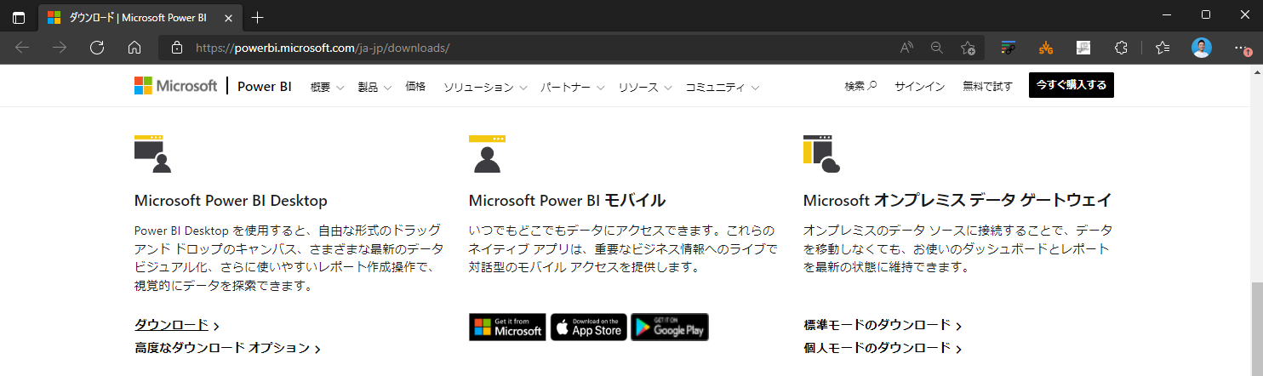

Slide 5
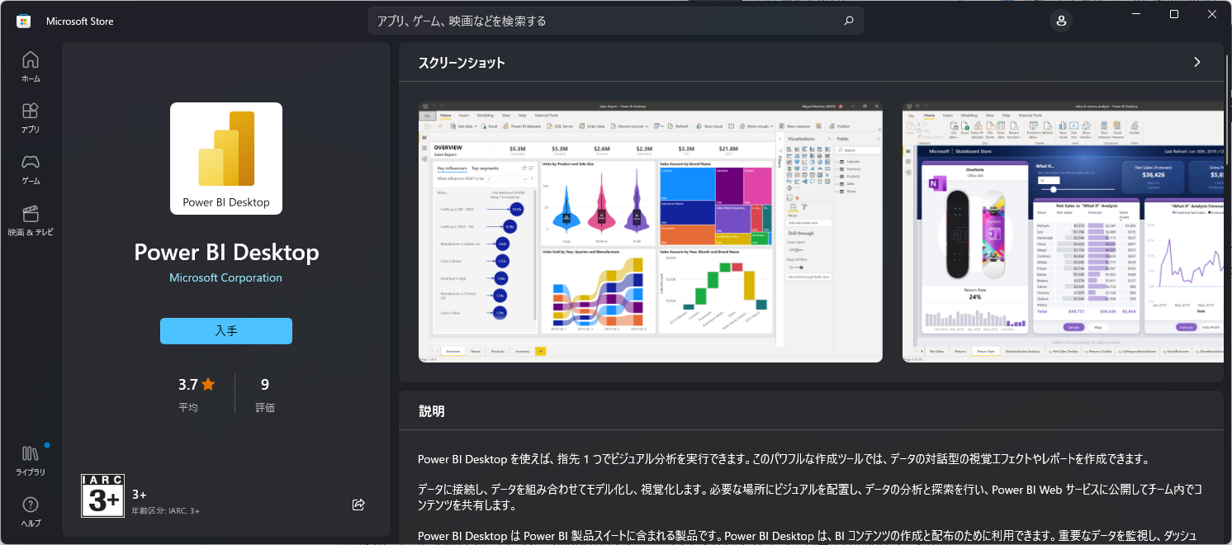

Slide 6
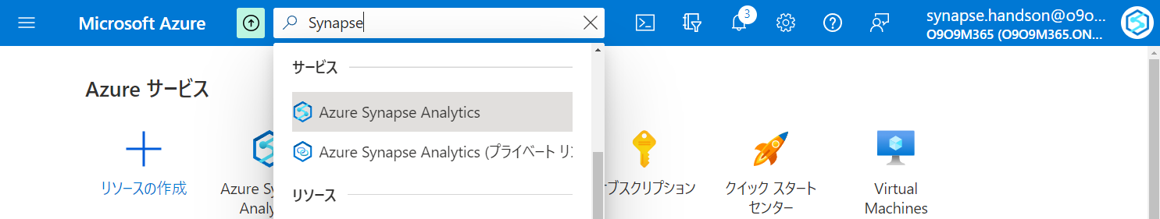

Slide 7
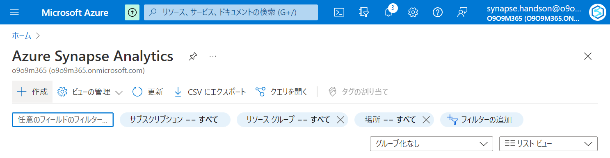

Slide 8
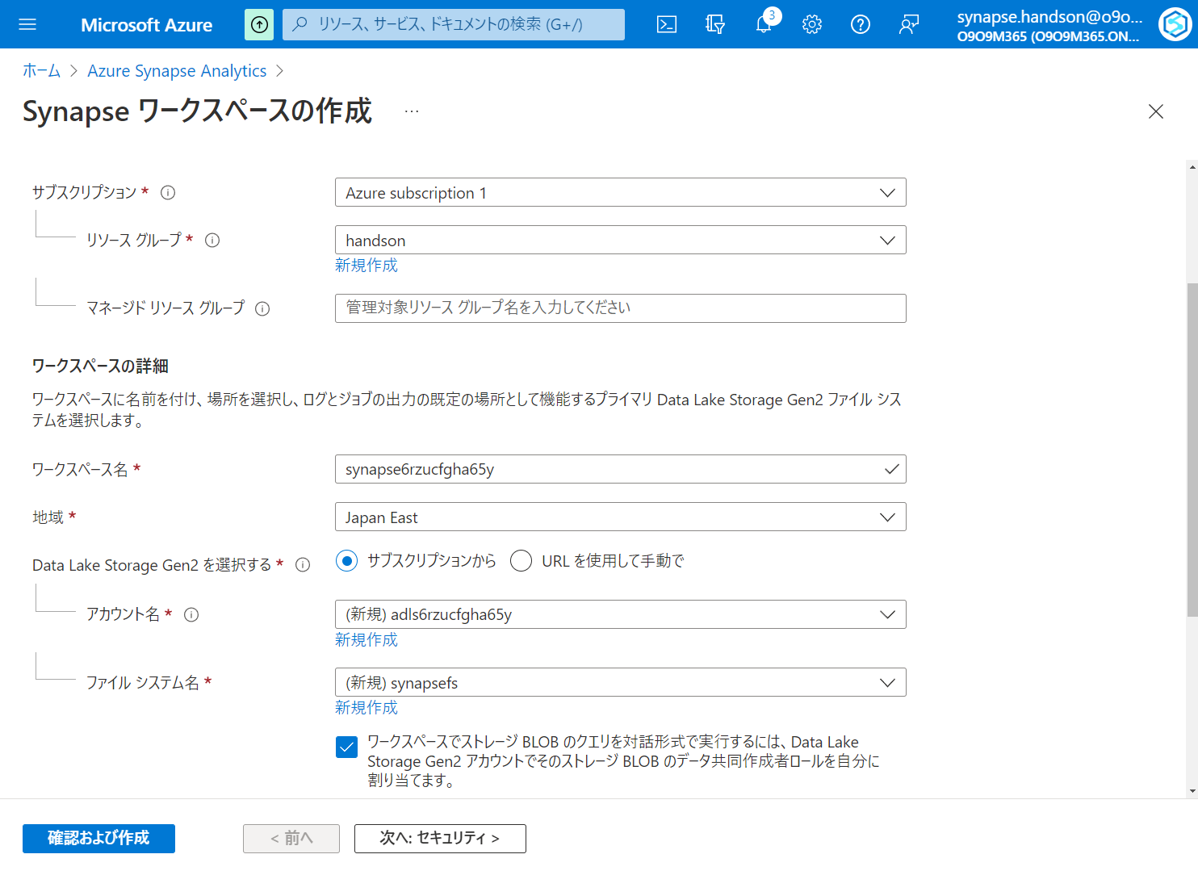

Slide 9
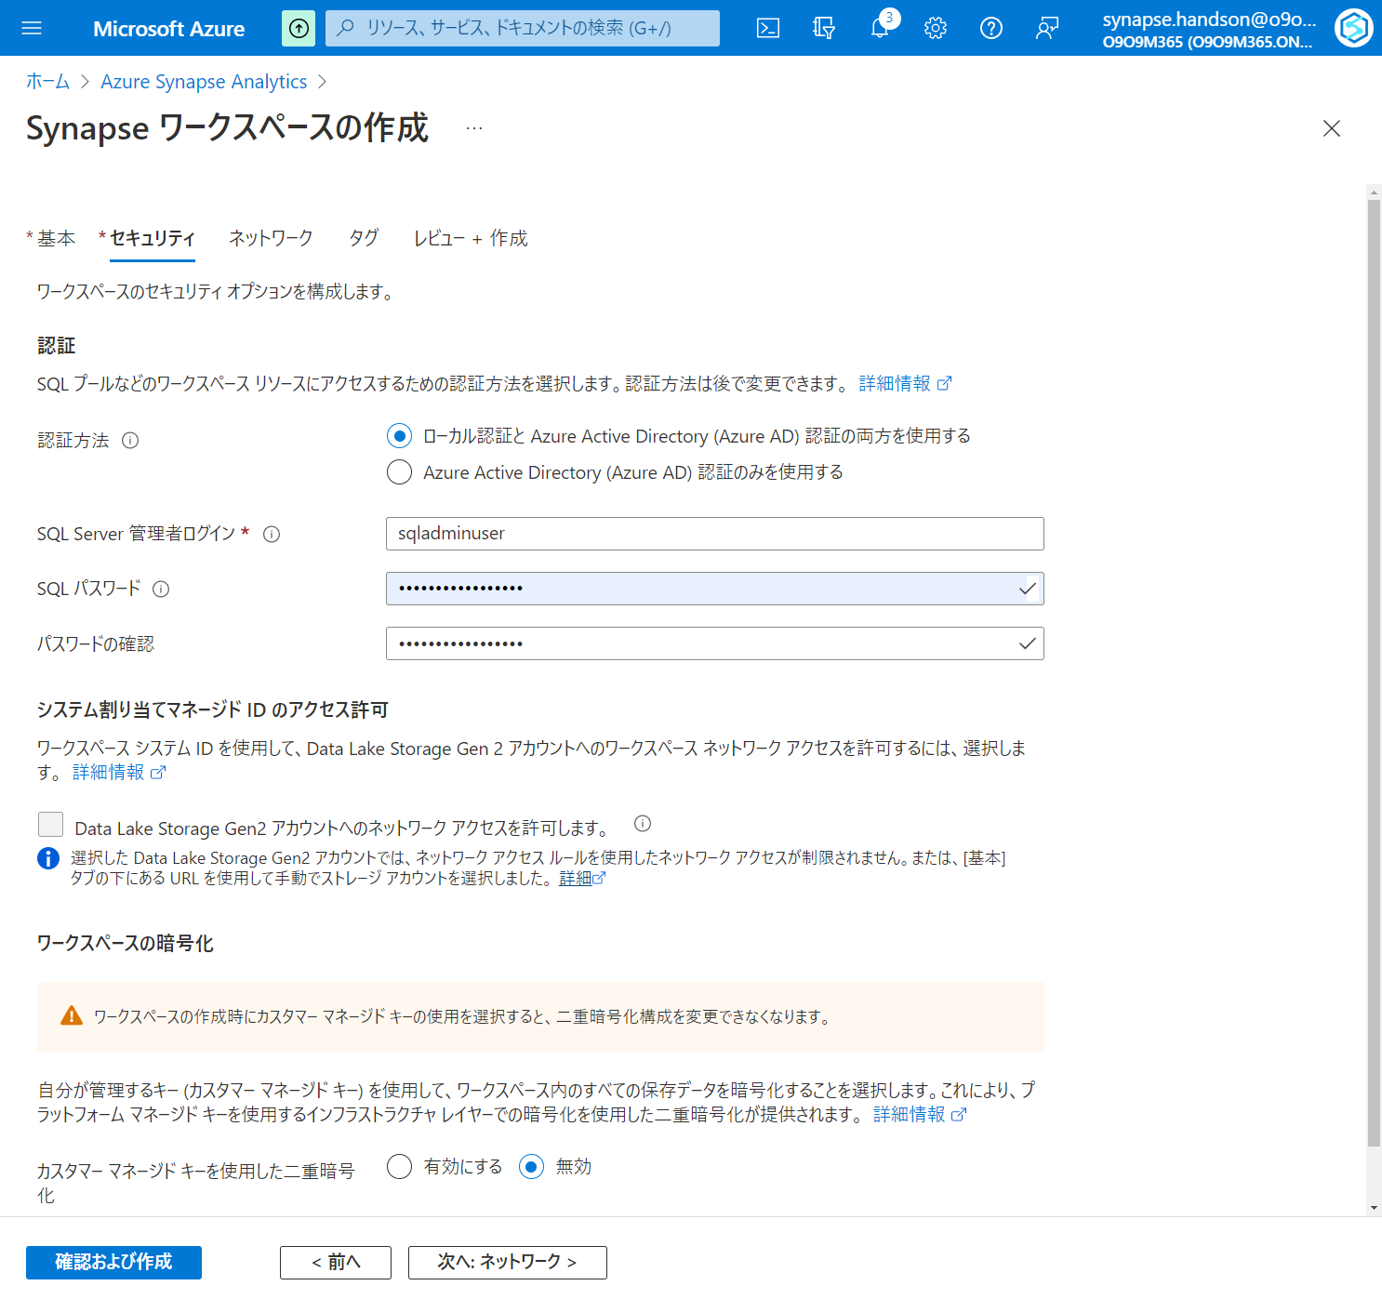

Slide 10
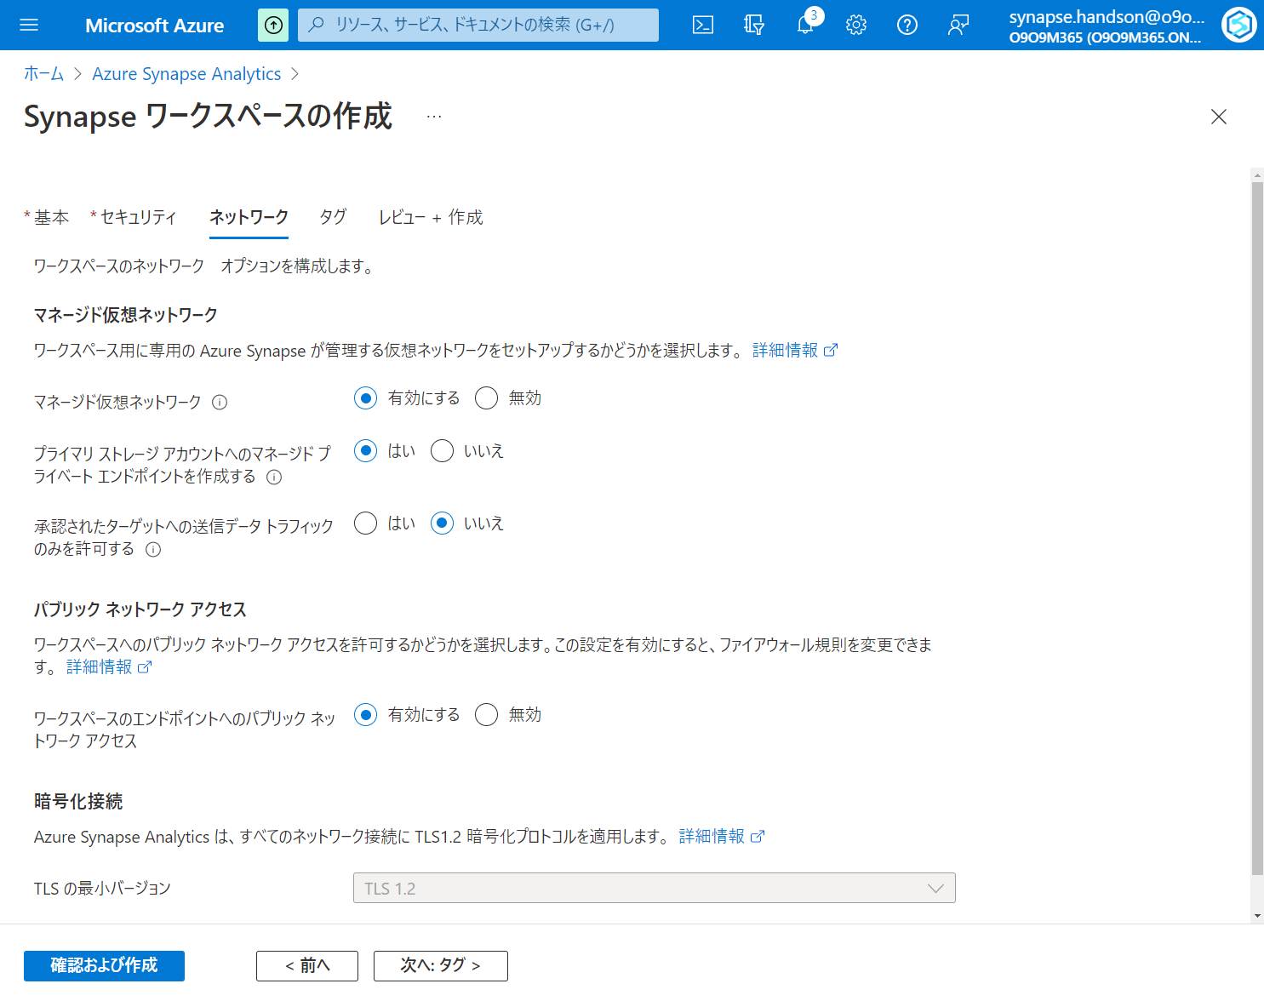

Slide 11
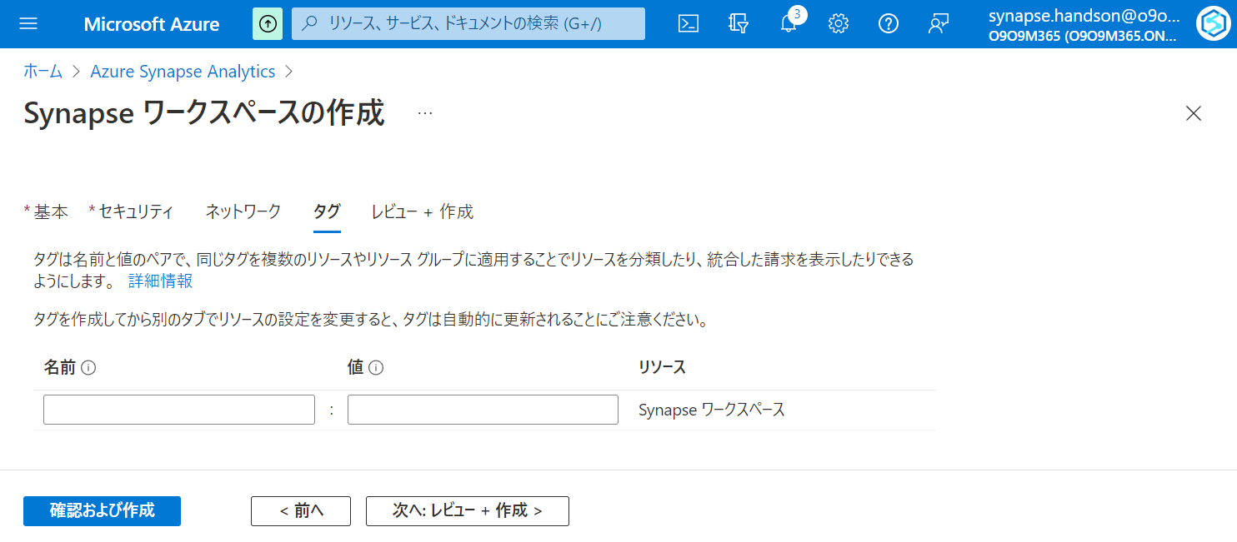

Slide 12
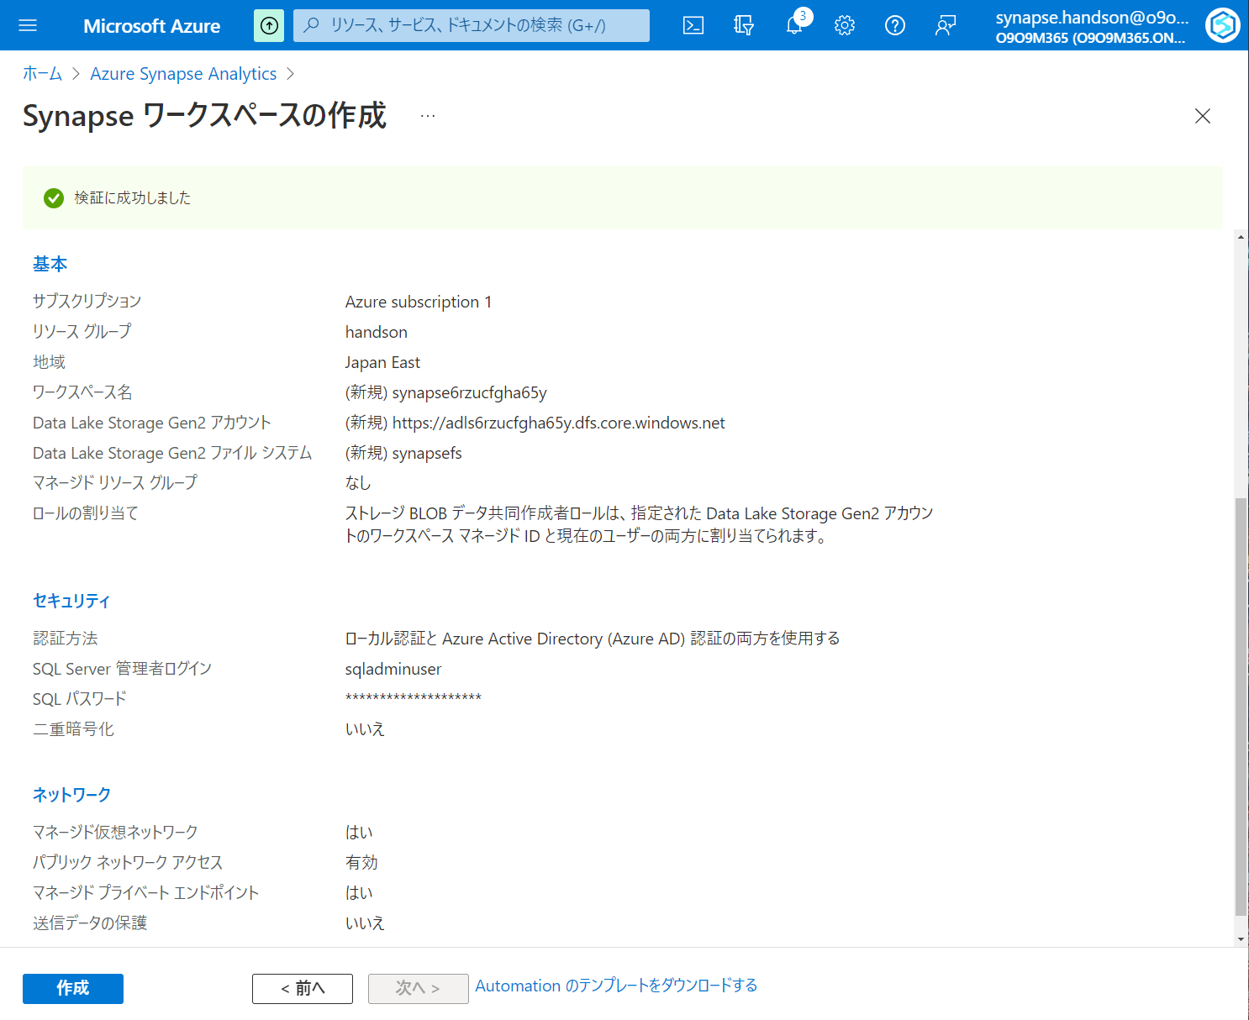

Slide 13
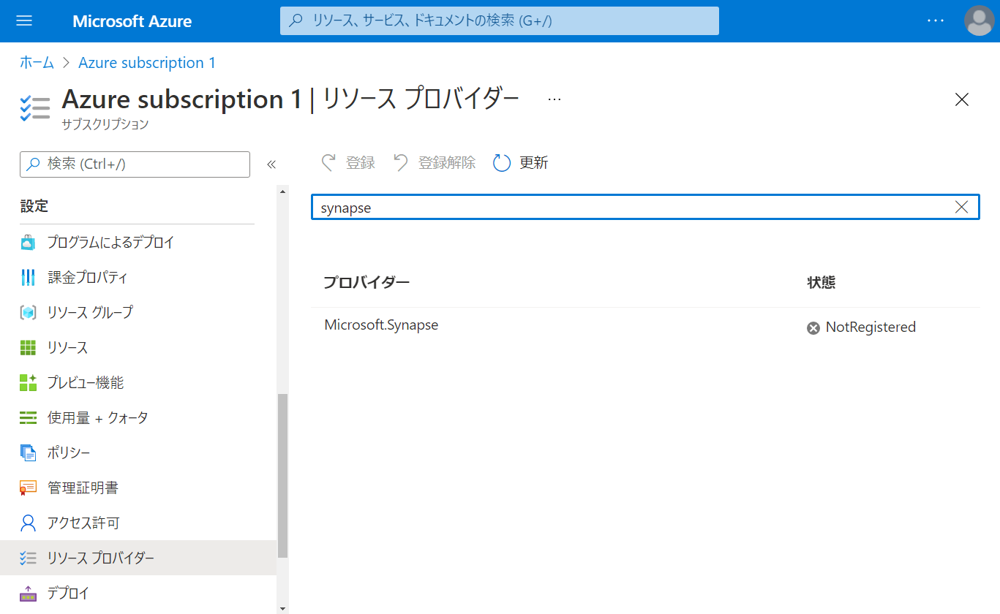

Slide 14
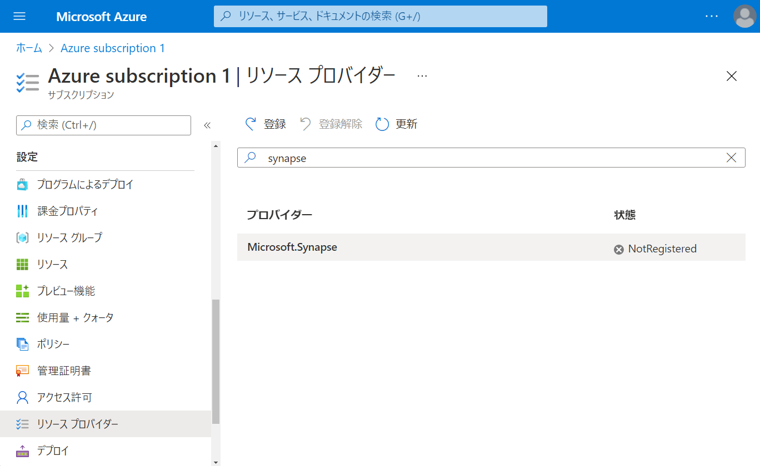

Slide 15
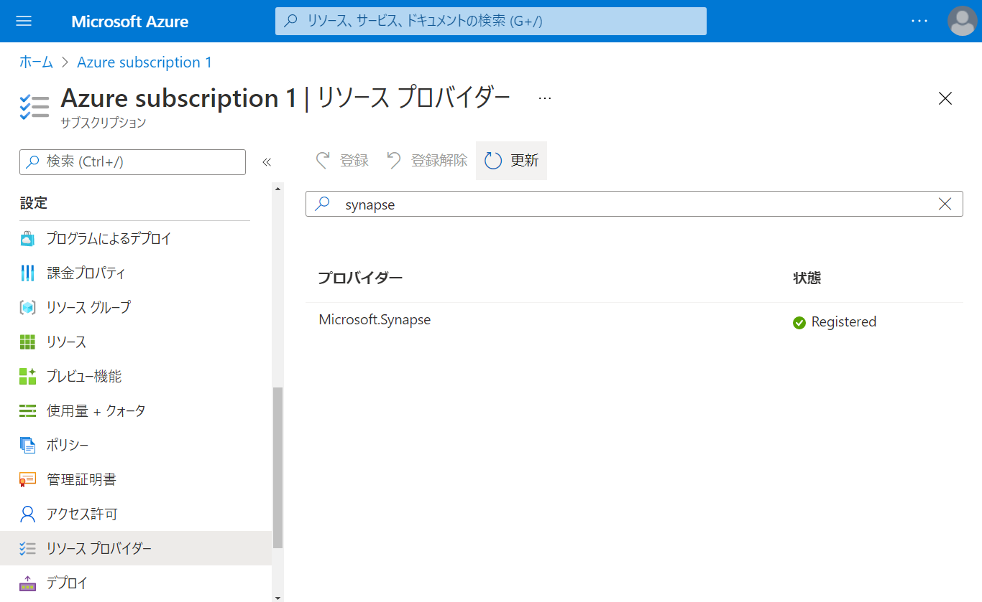

Slide 16
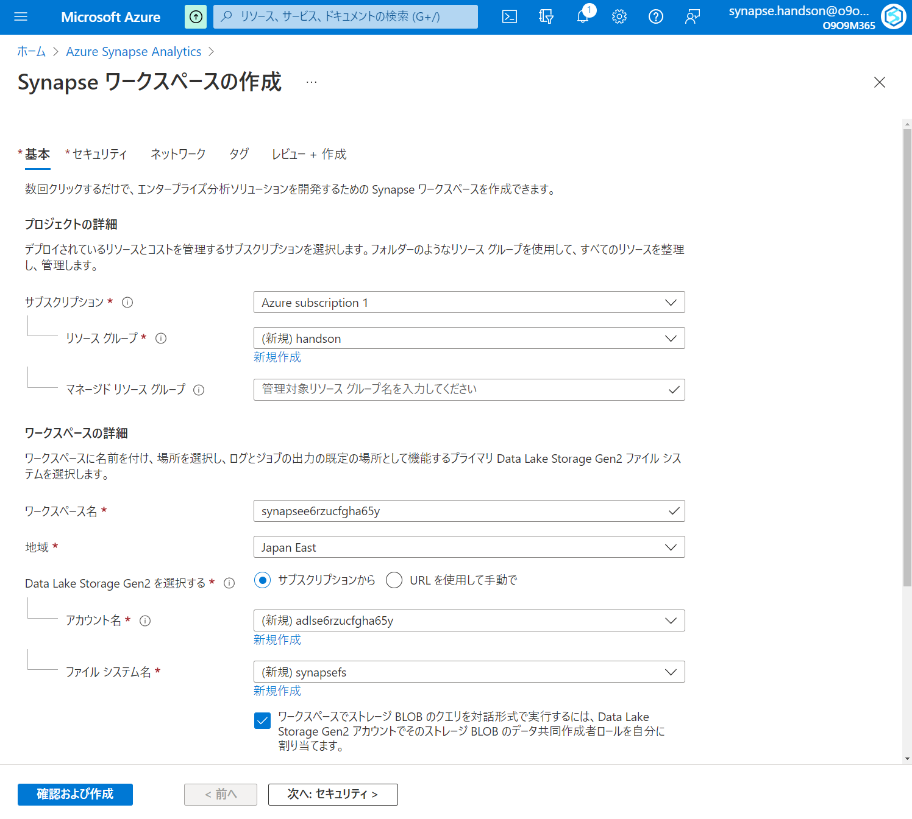

Slide 17
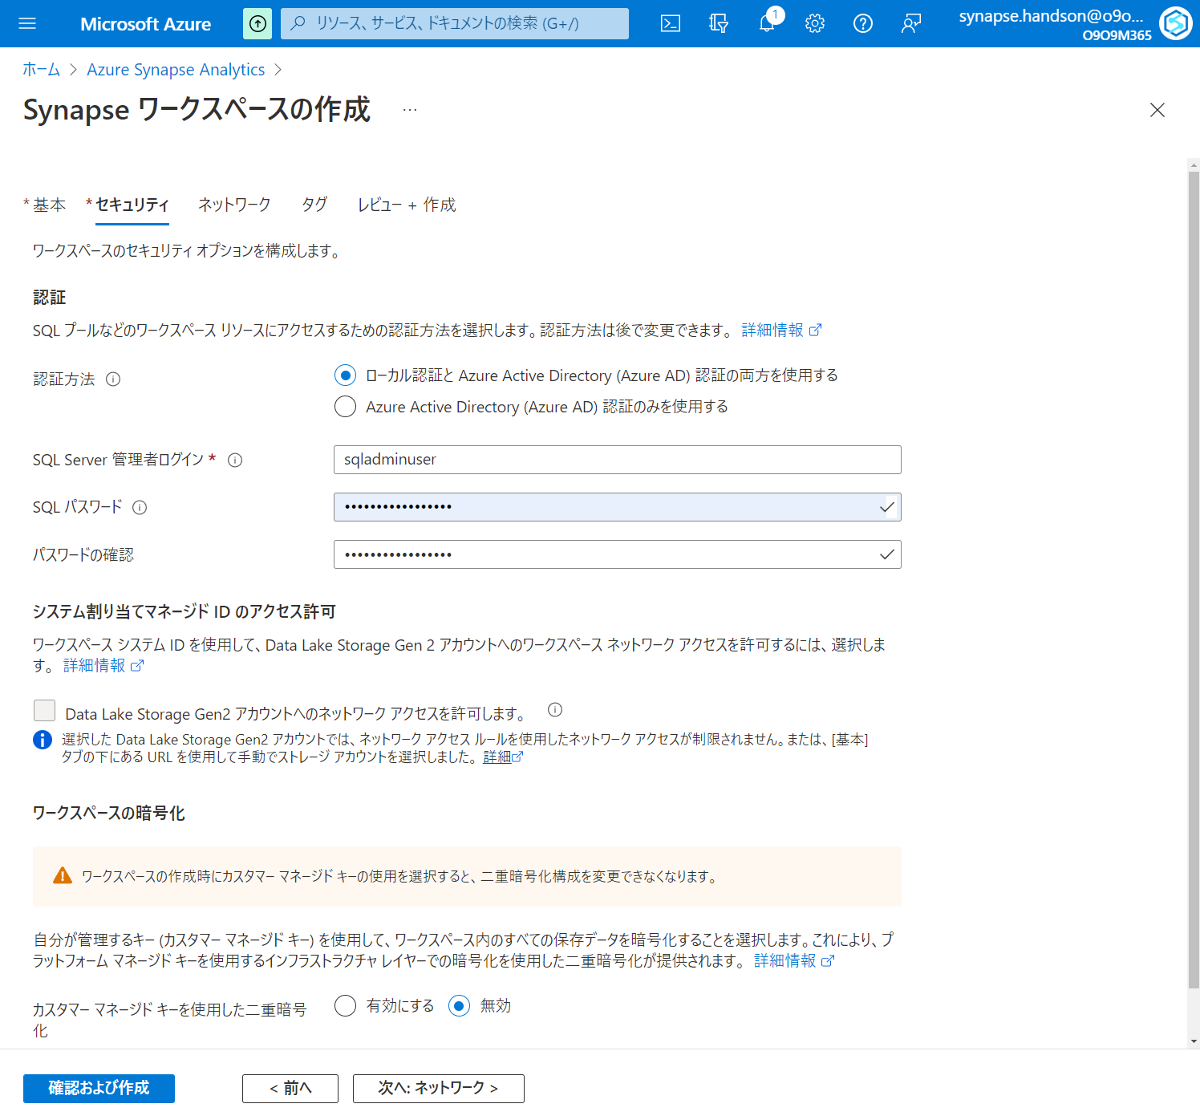

Slide 18
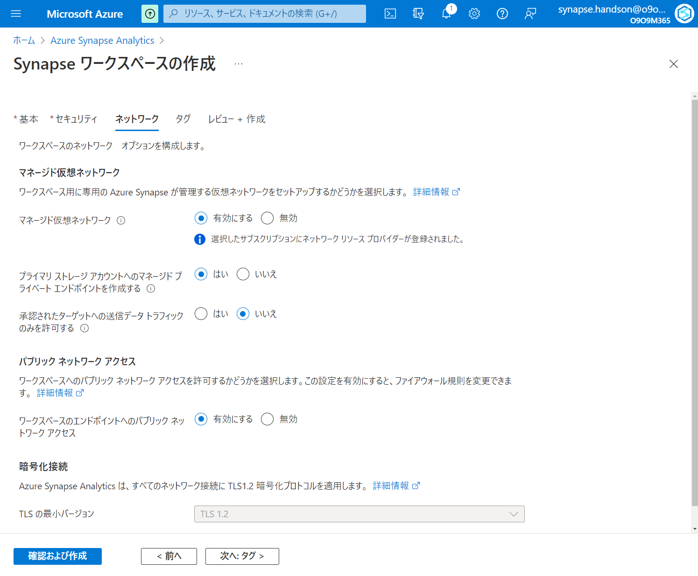

Slide 19
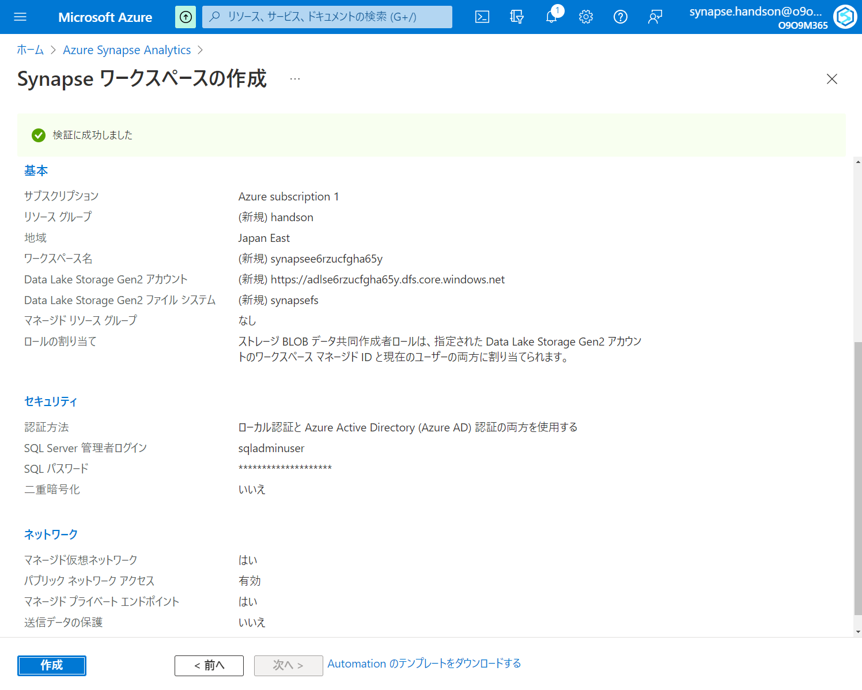

Slide 20
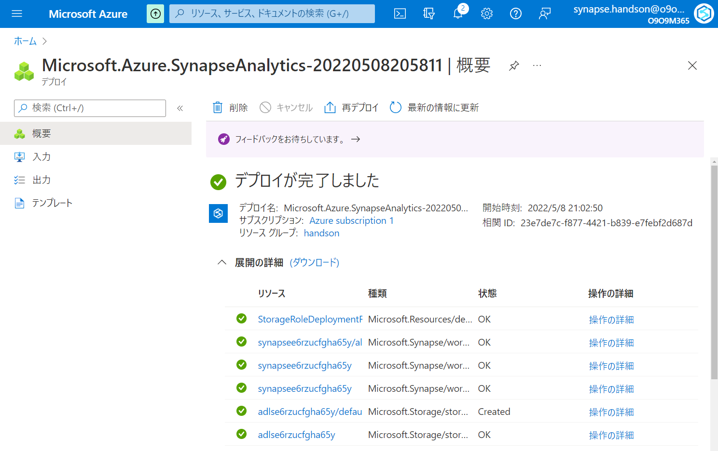

Slide 21
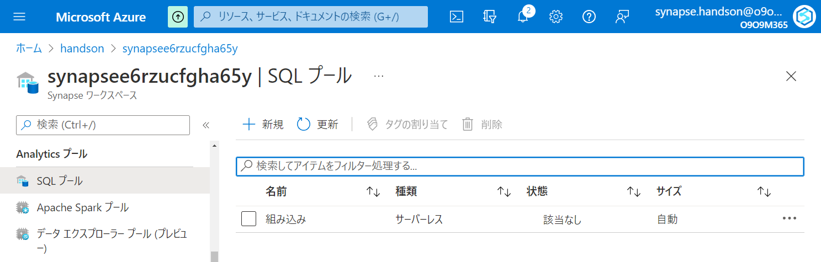

Slide 22
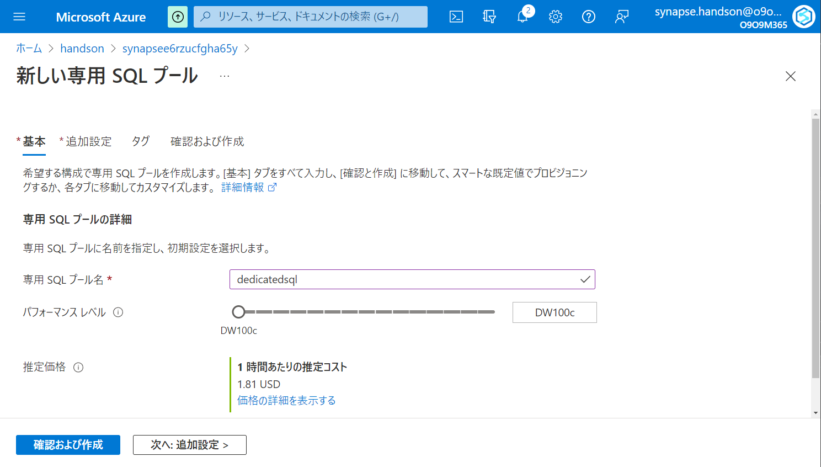

Slide 23
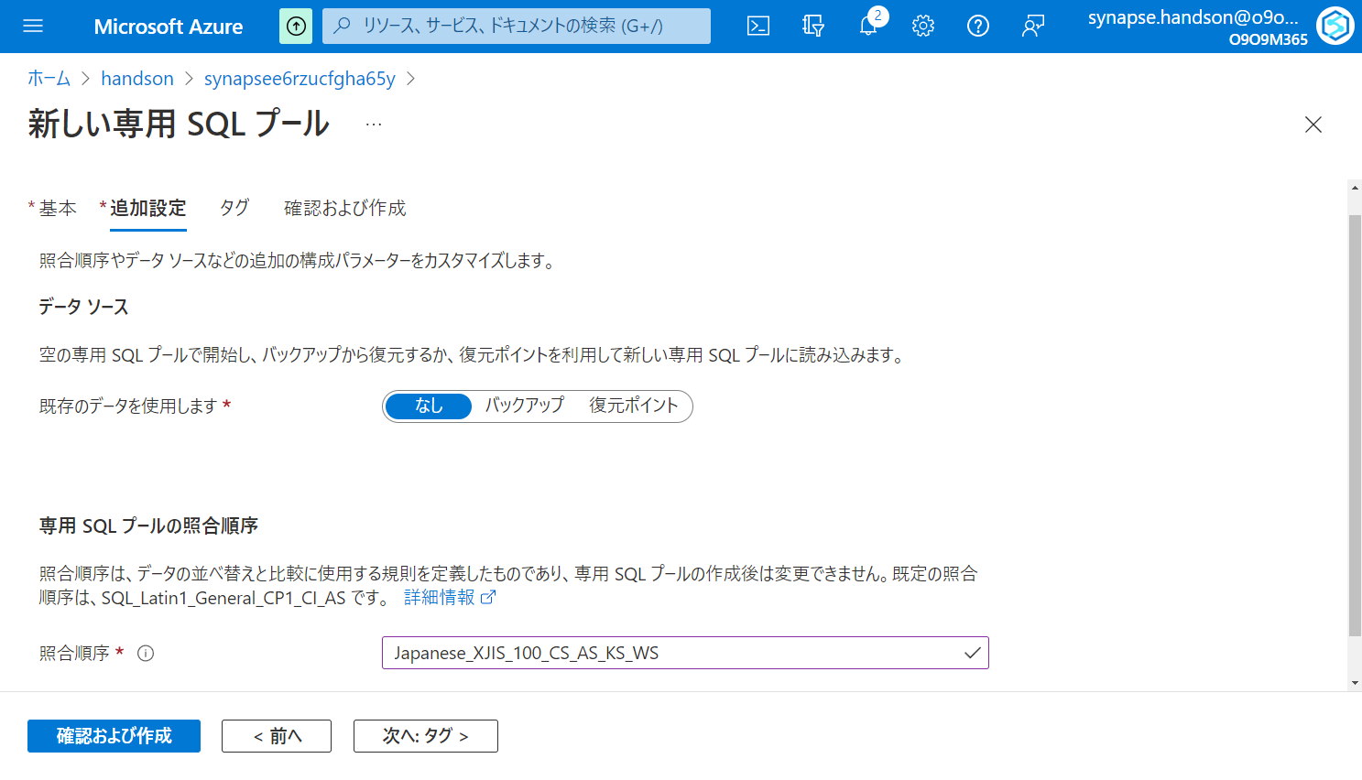

Slide 24
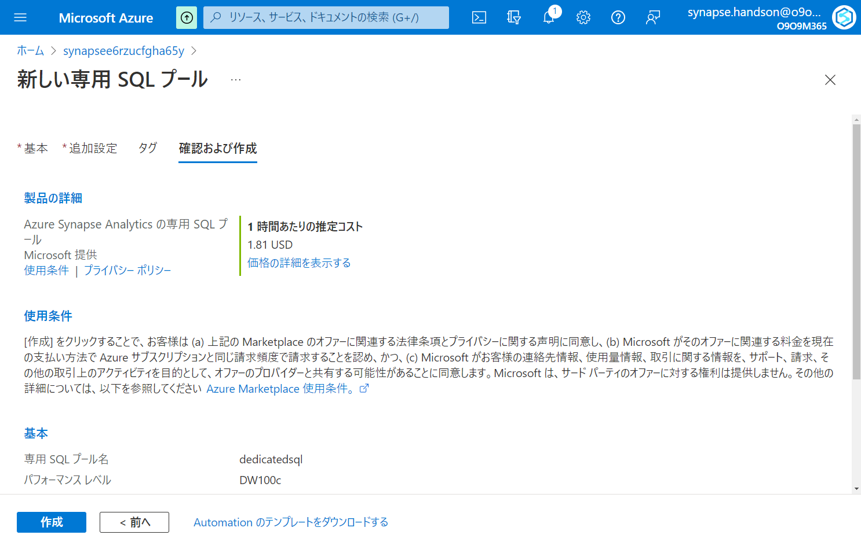

Slide 25
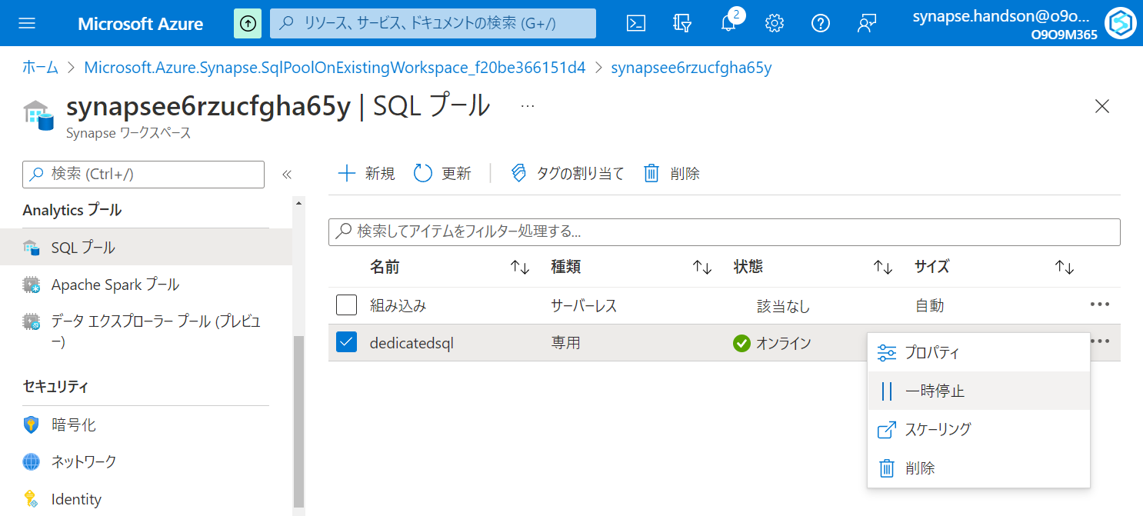

Slide 26
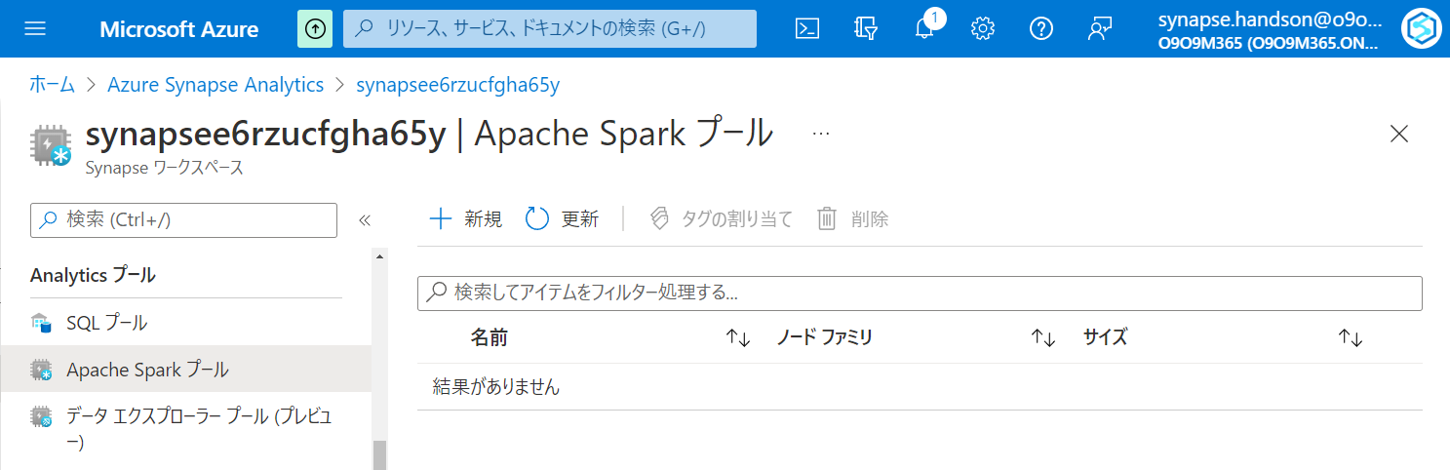

Slide 27
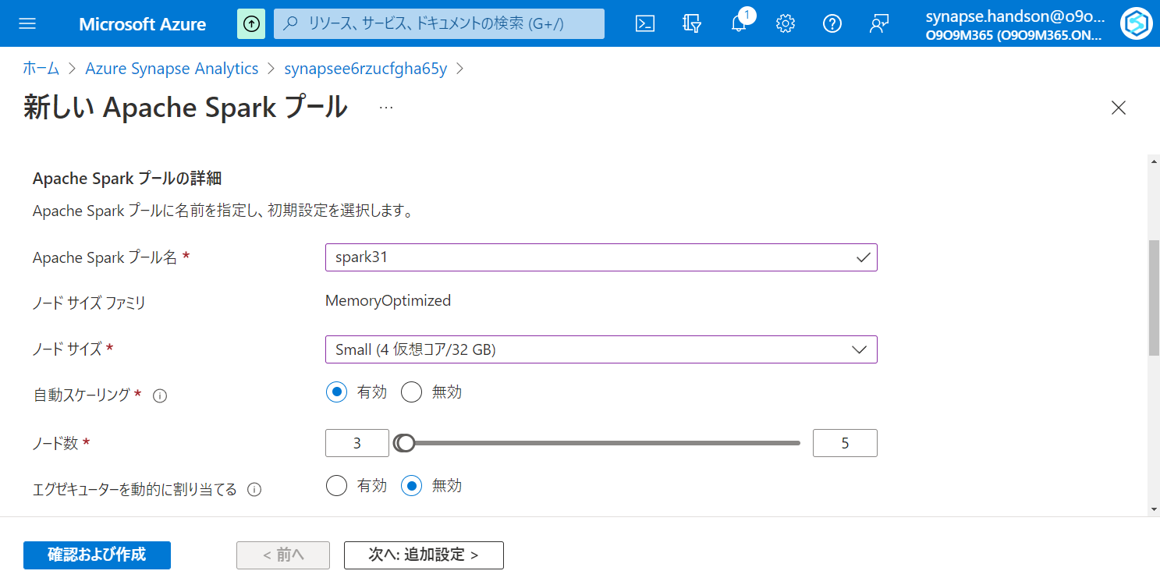

Slide 28
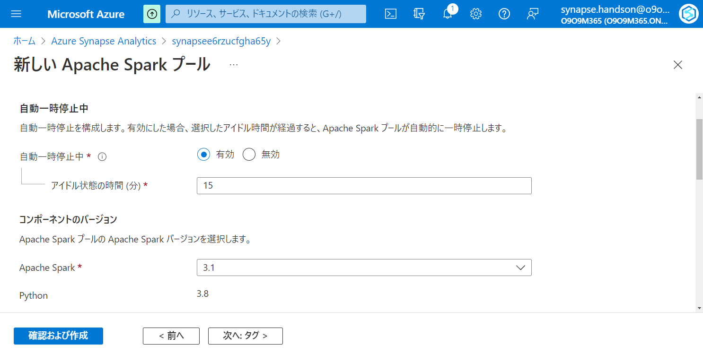

Slide 29
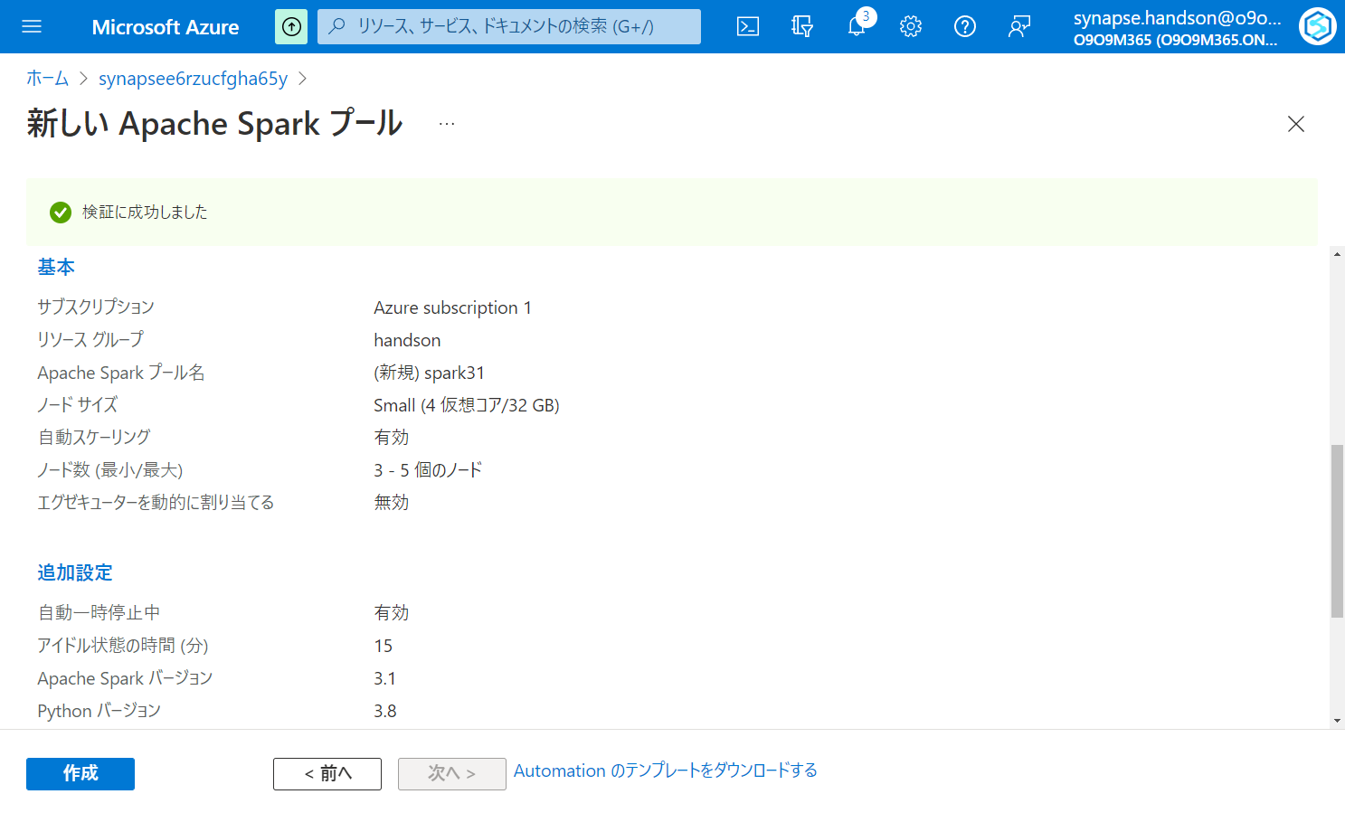

Slide 30
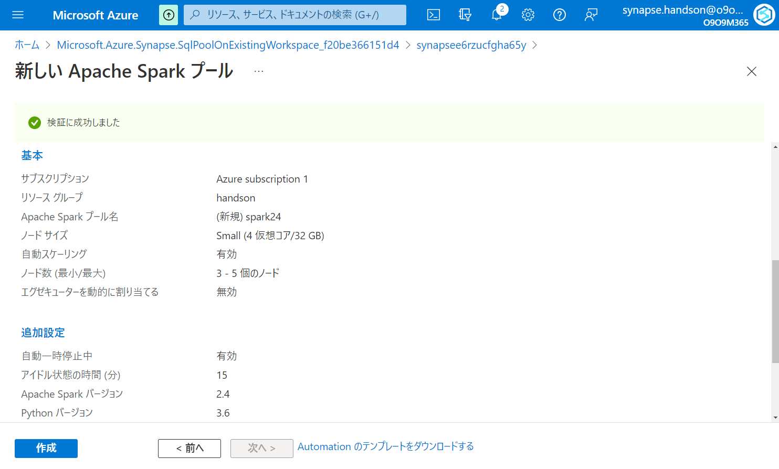

Slide 31
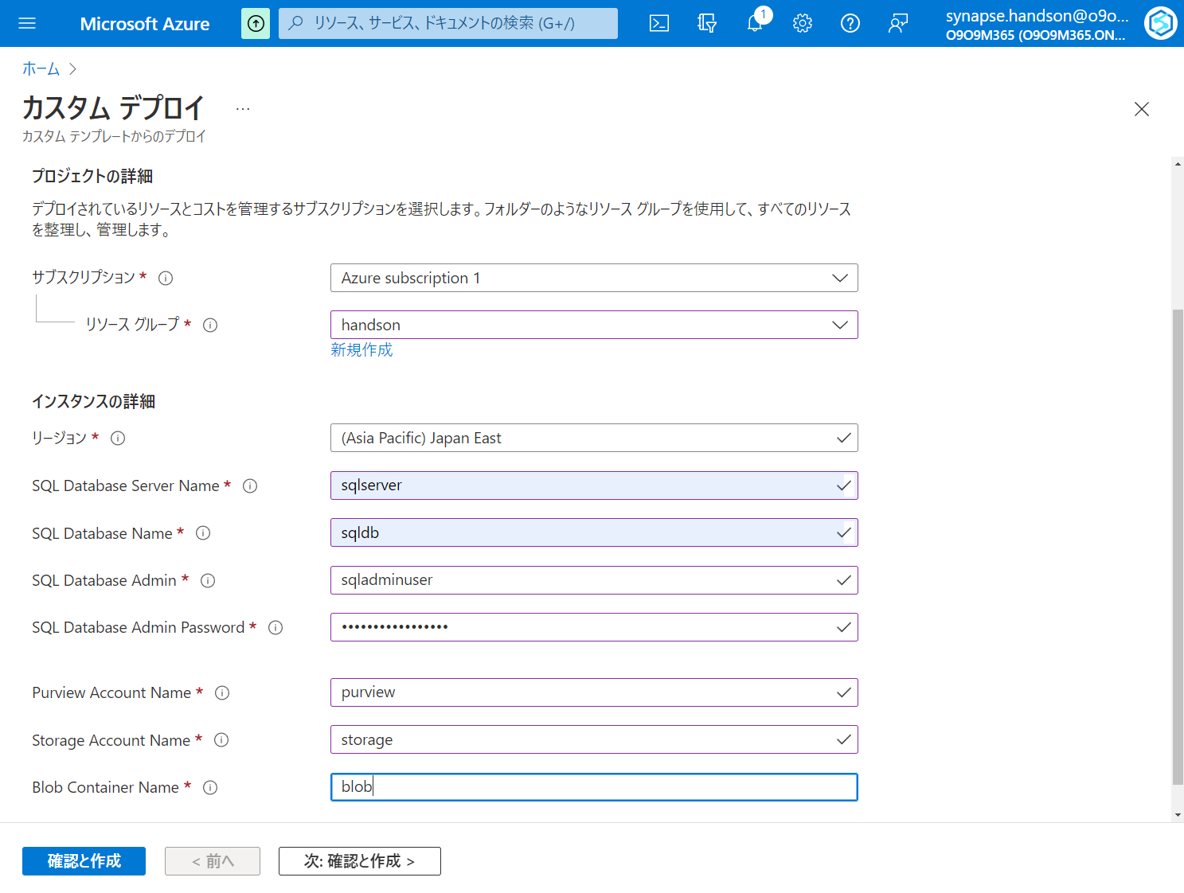

Slide 32
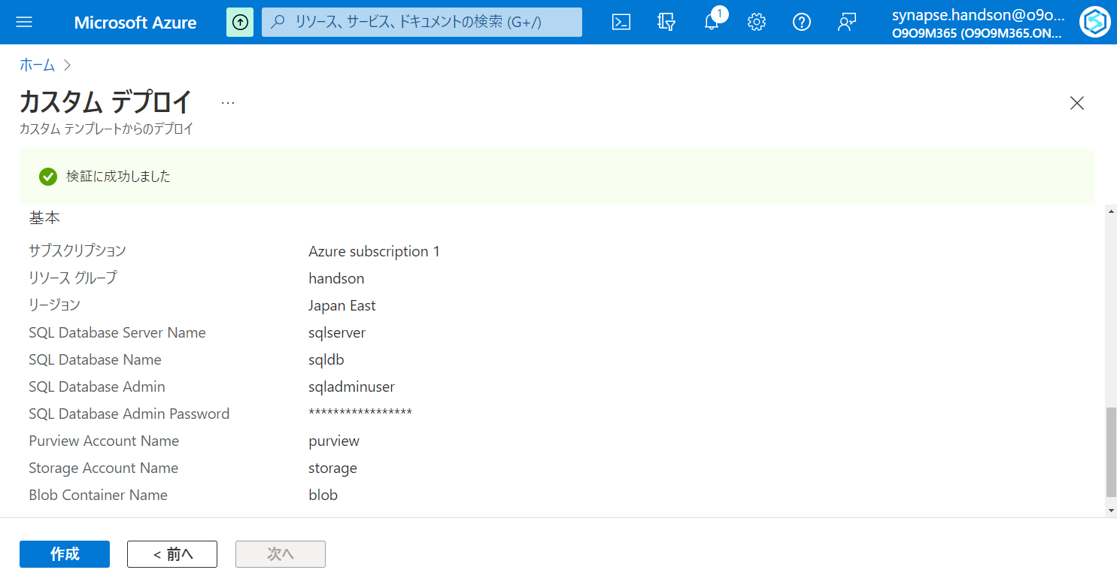

Slide 33
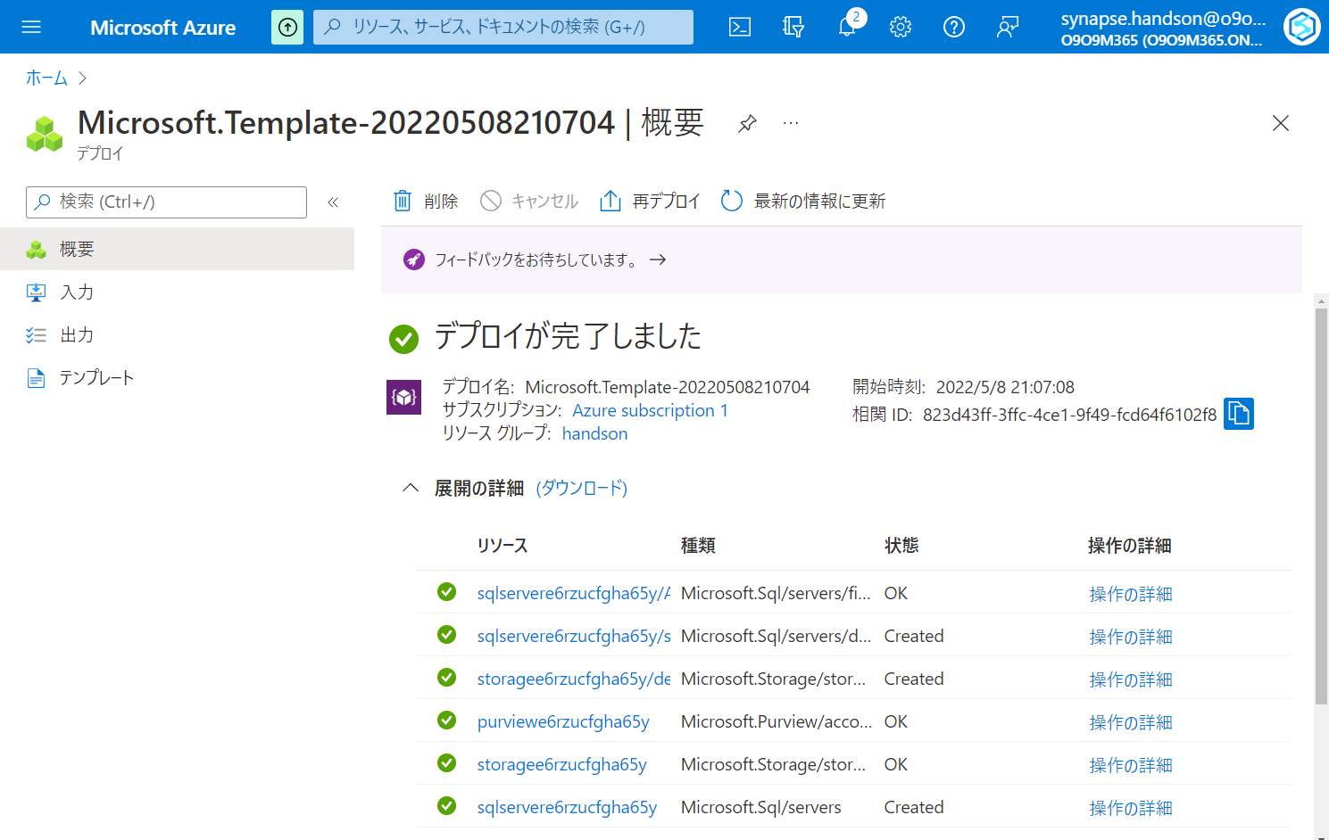

Slide 34
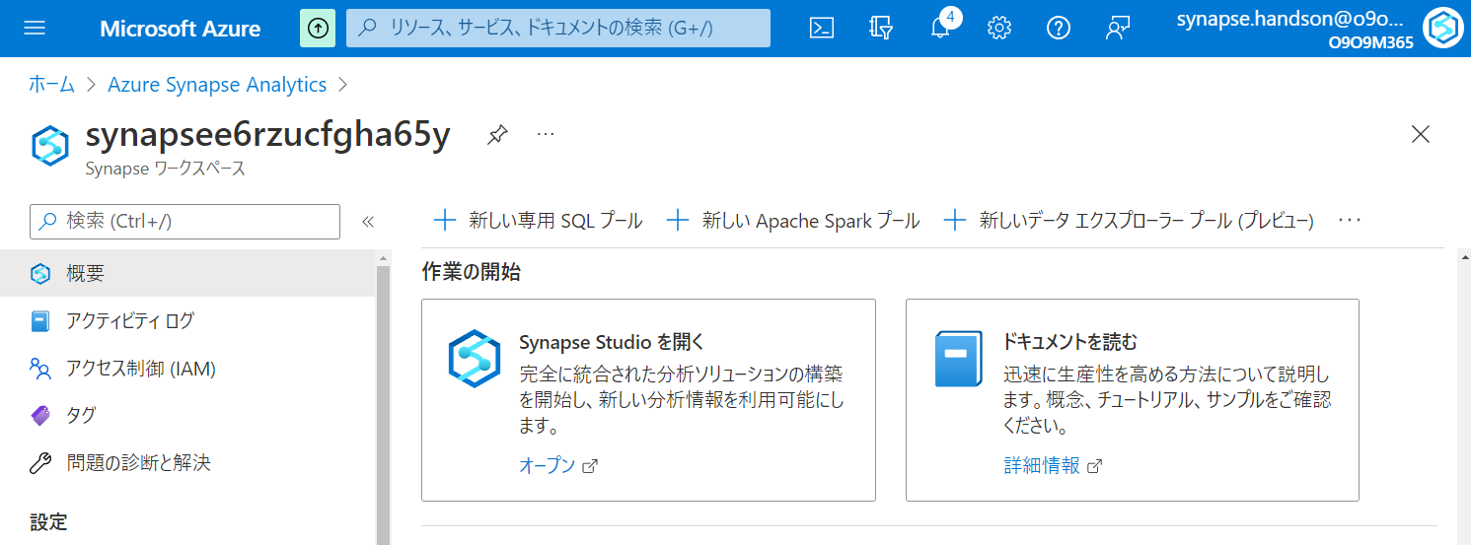

Slide 35
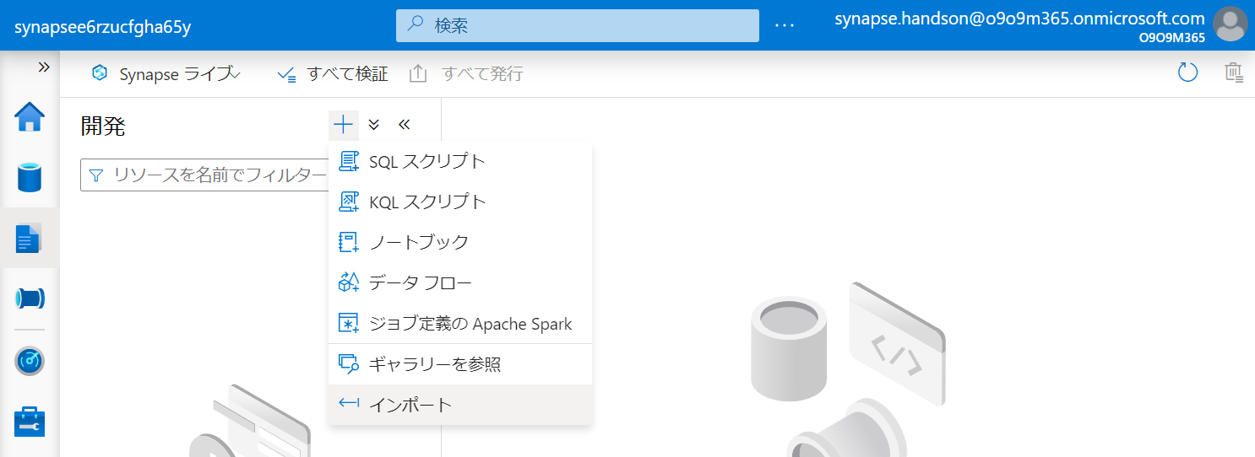

Slide 36
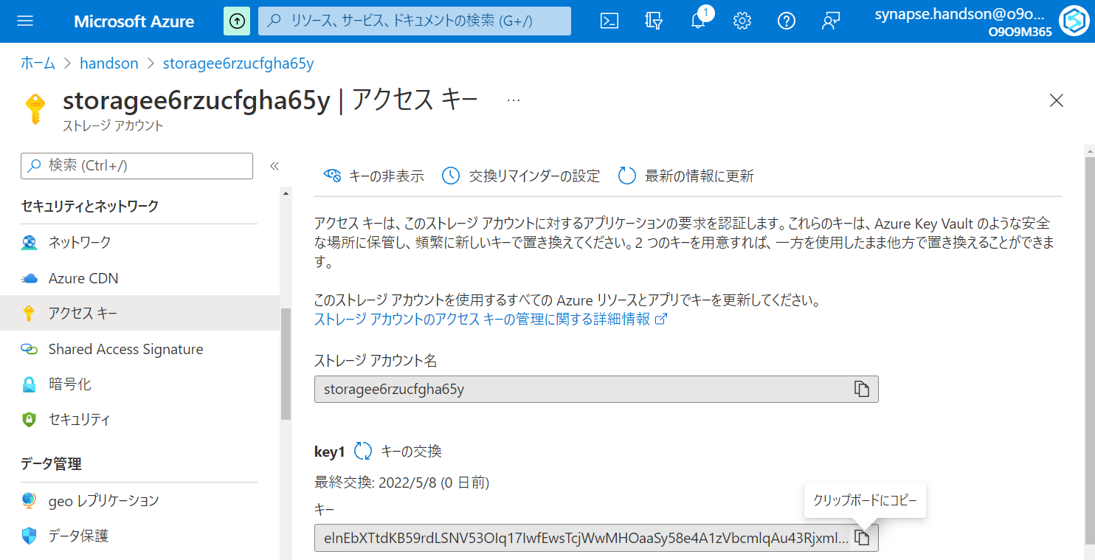

Slide 37
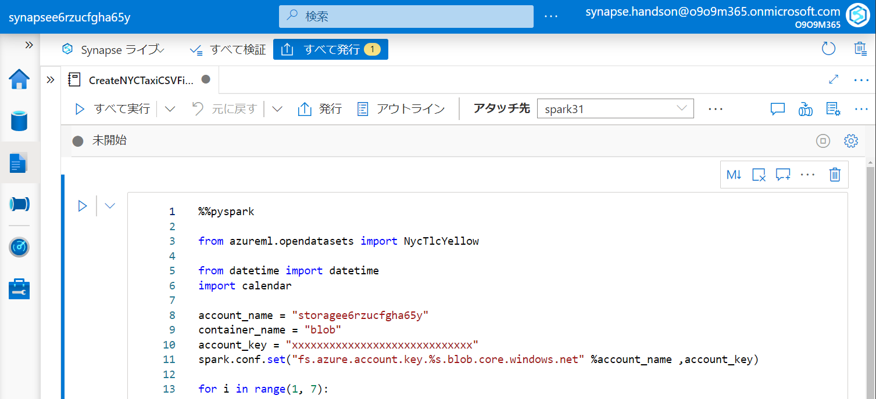

Slide 38
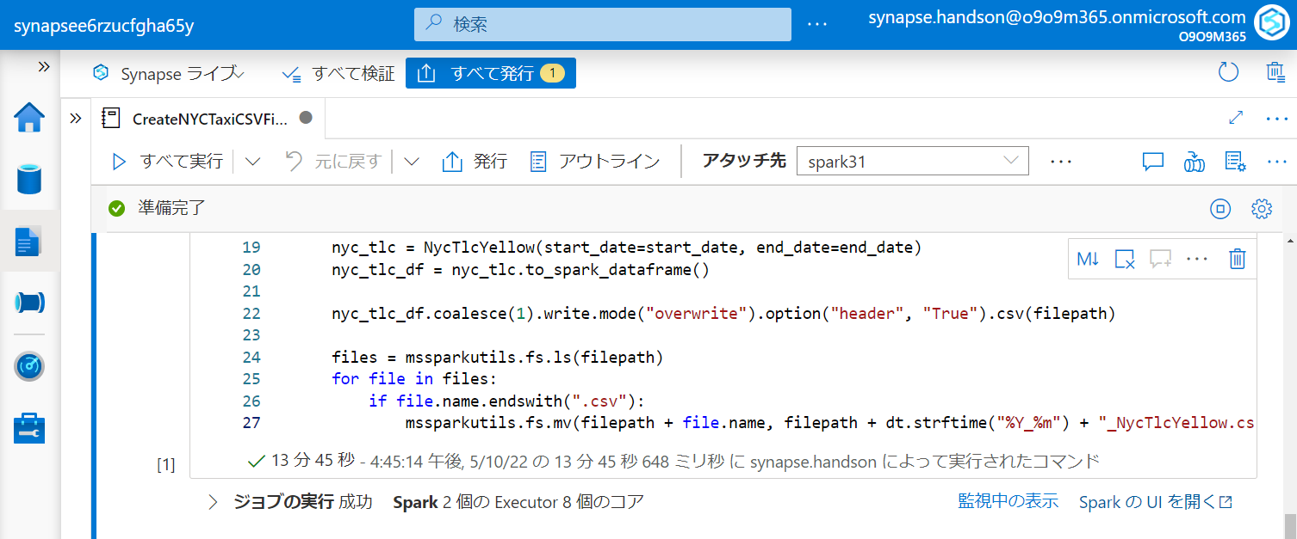

Slide 39
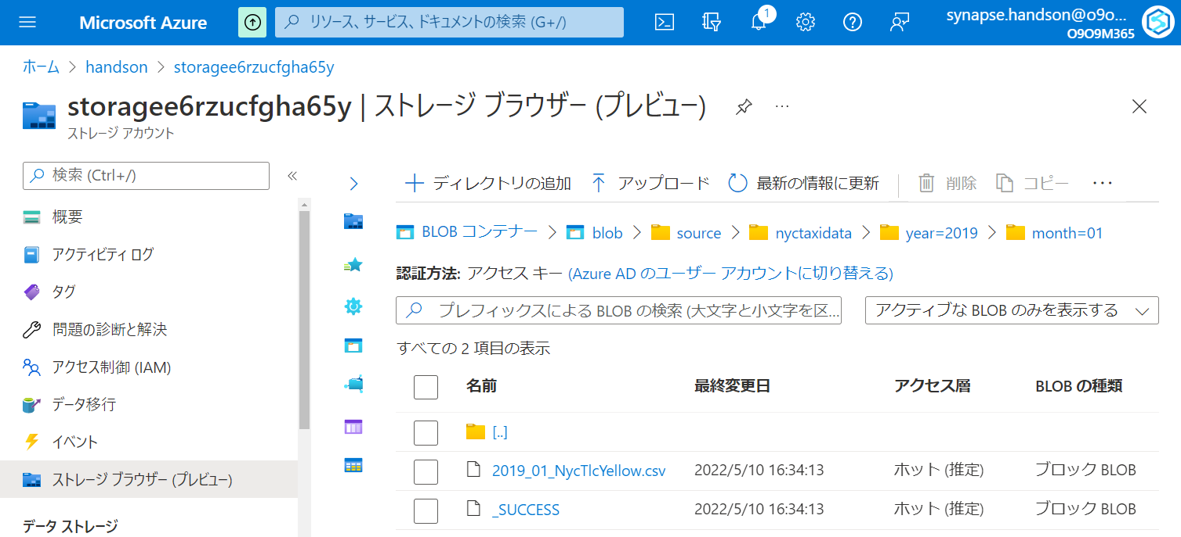

Slide 40
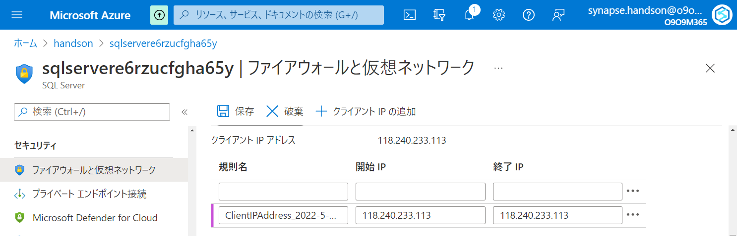

Slide 41
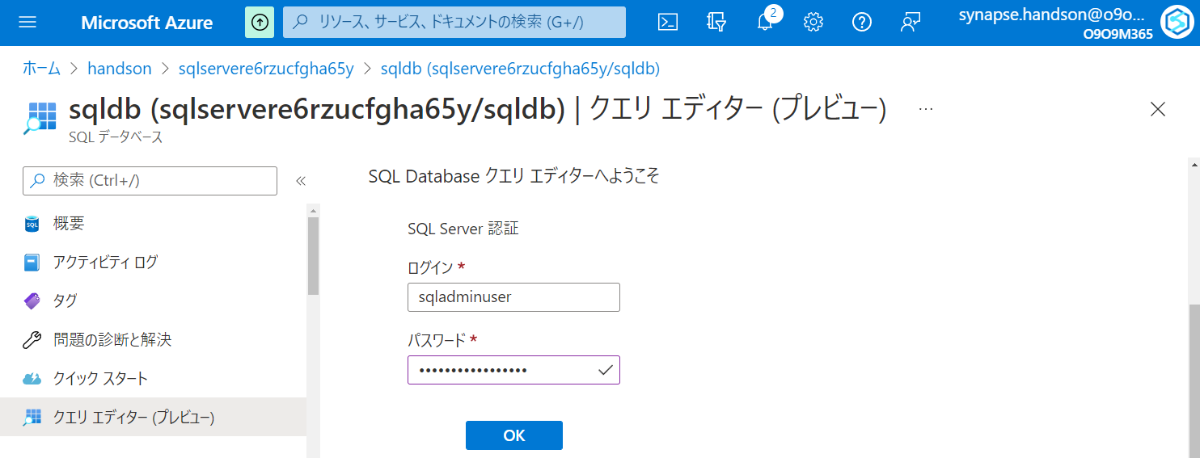

Slide 42
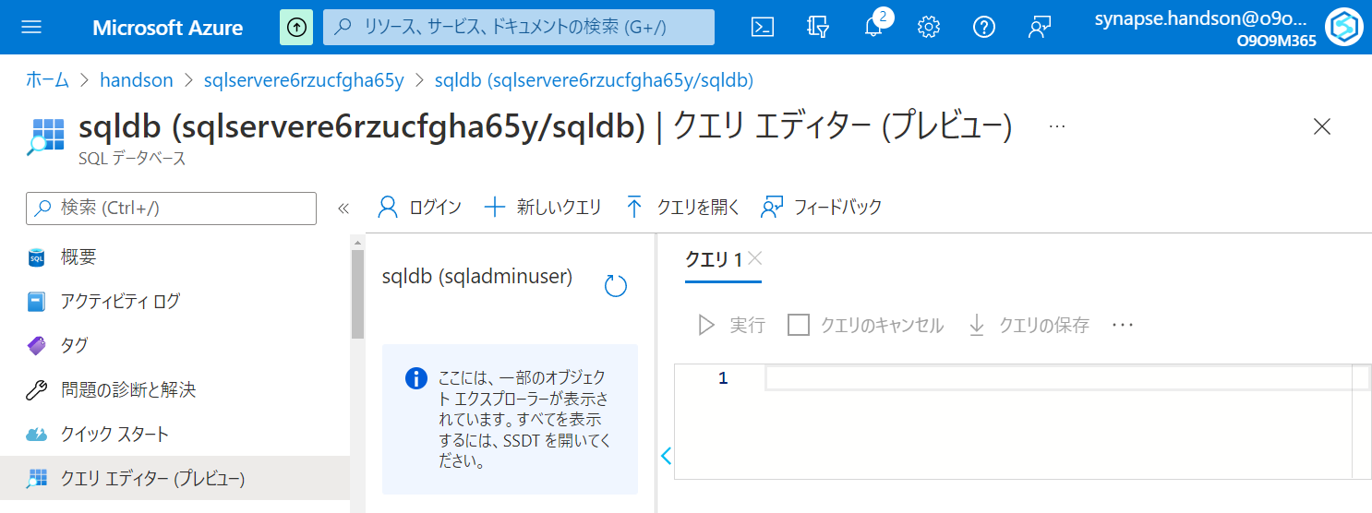

Slide 43
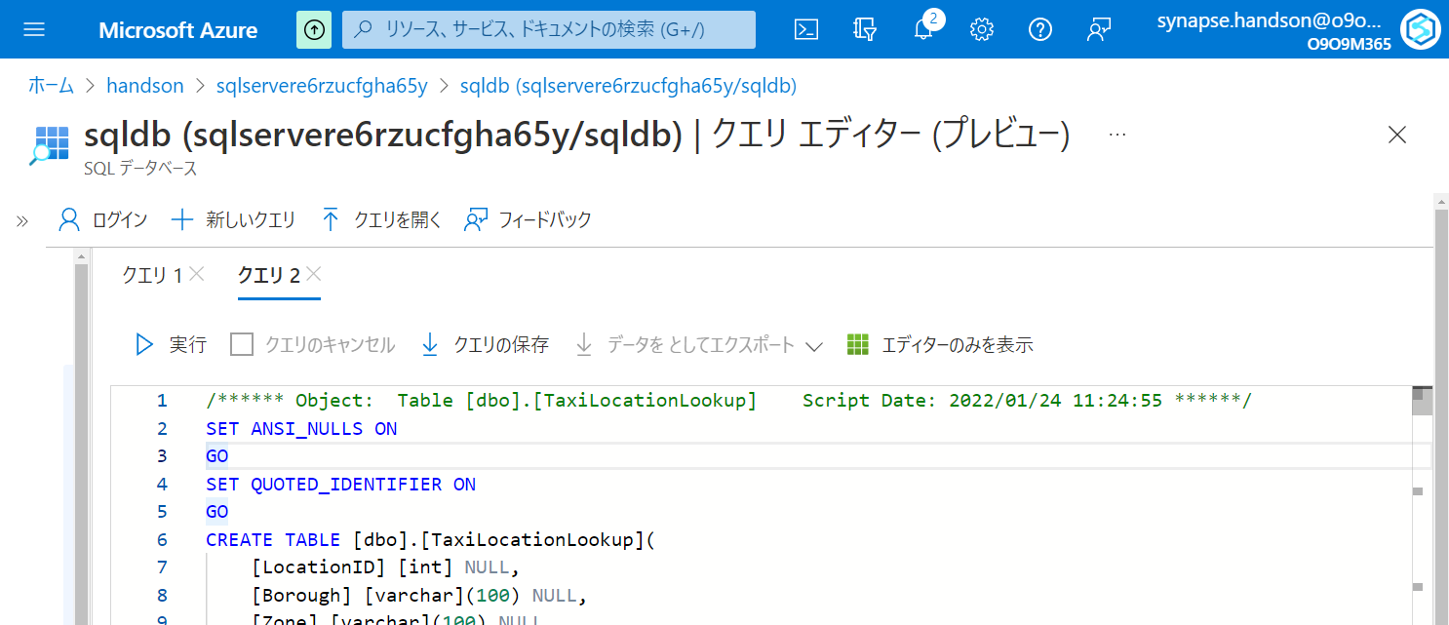

Slide 44
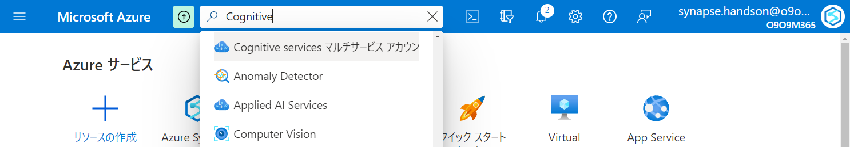

Slide 45
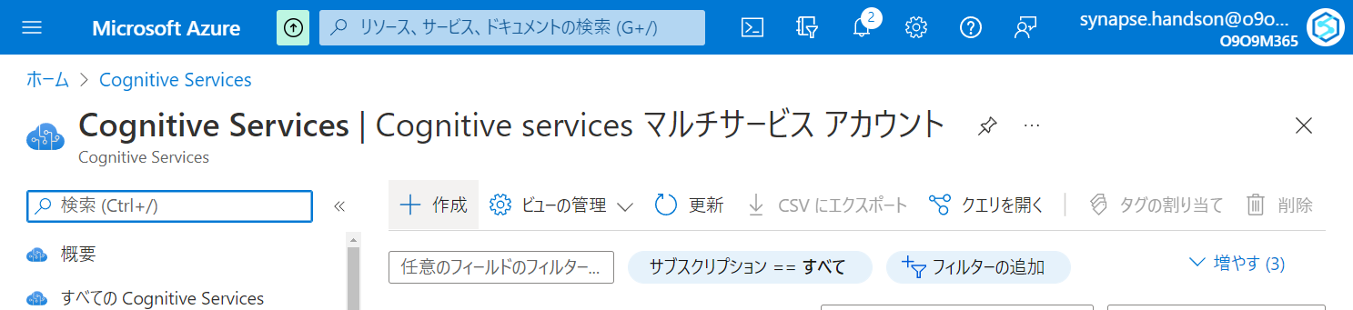

Slide 46
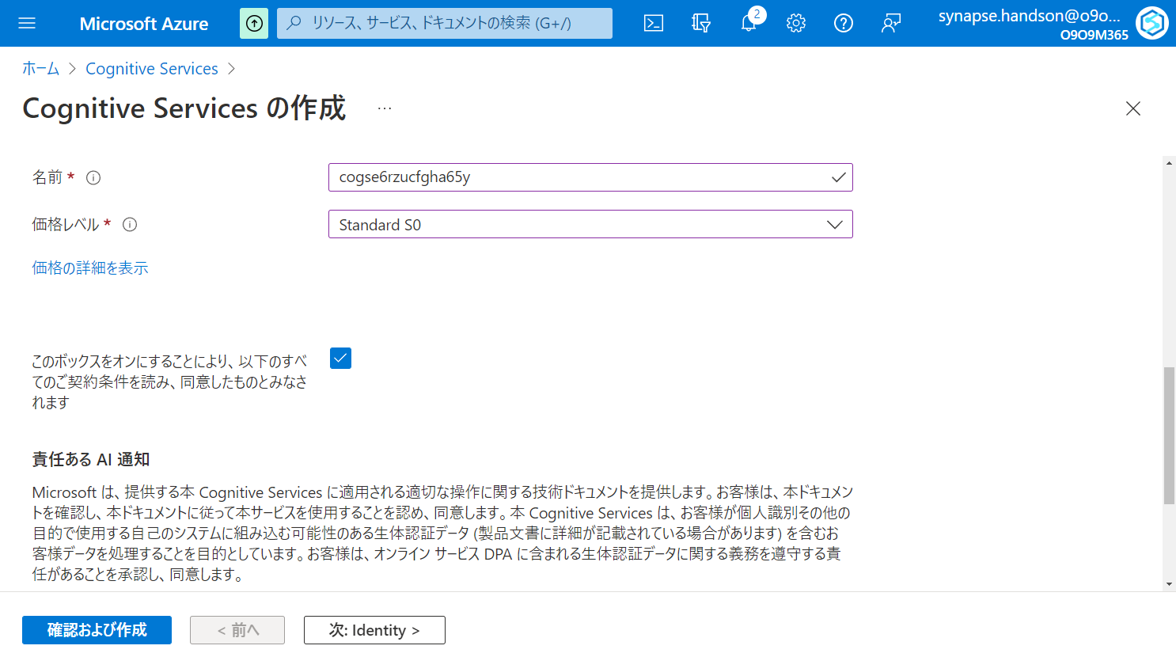

Slide 47
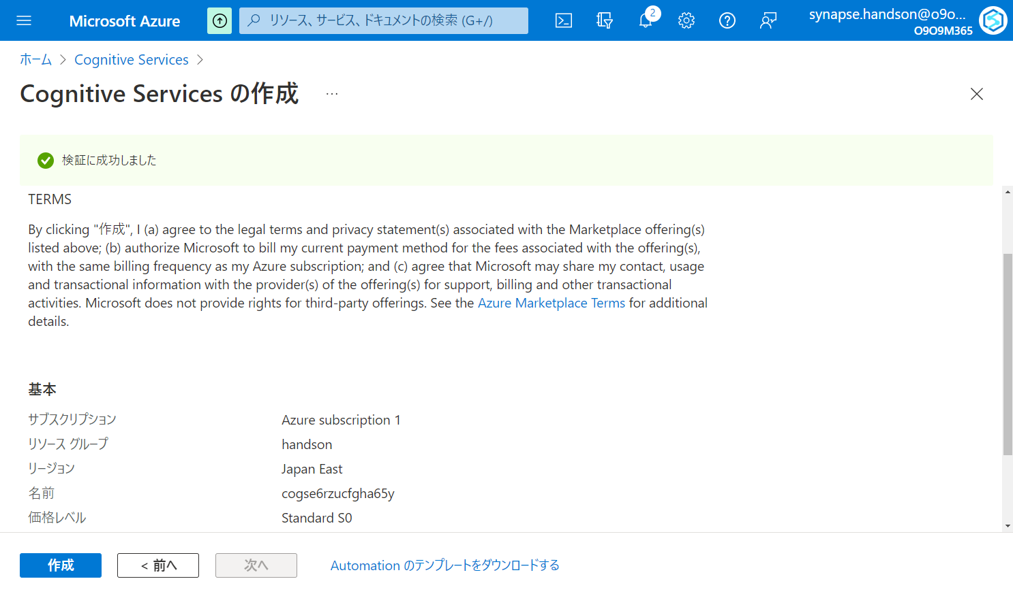

Slide 48
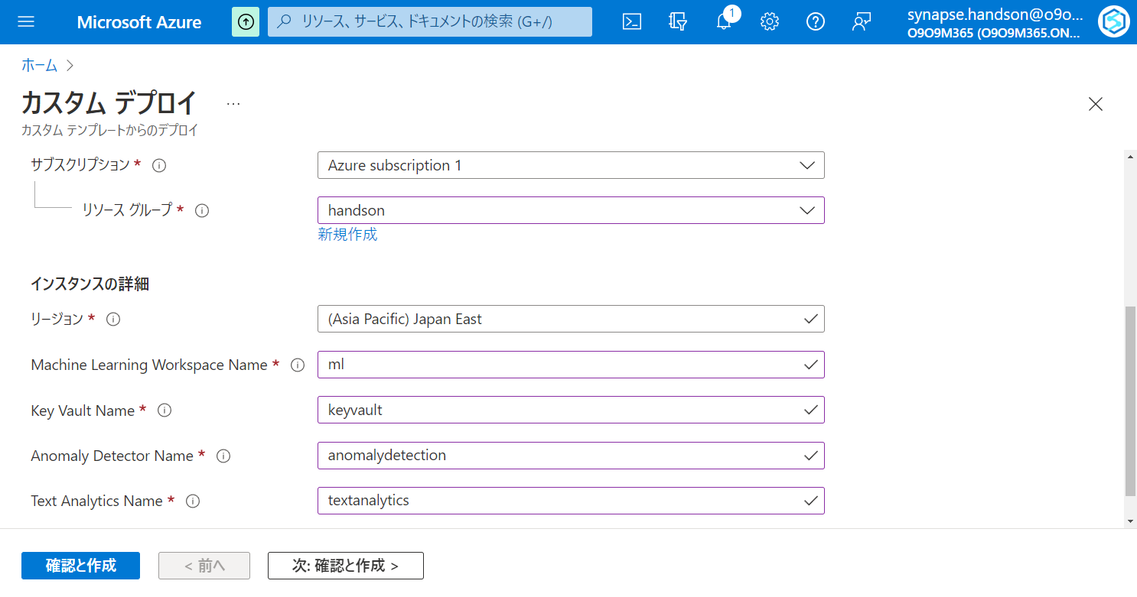

Slide 49
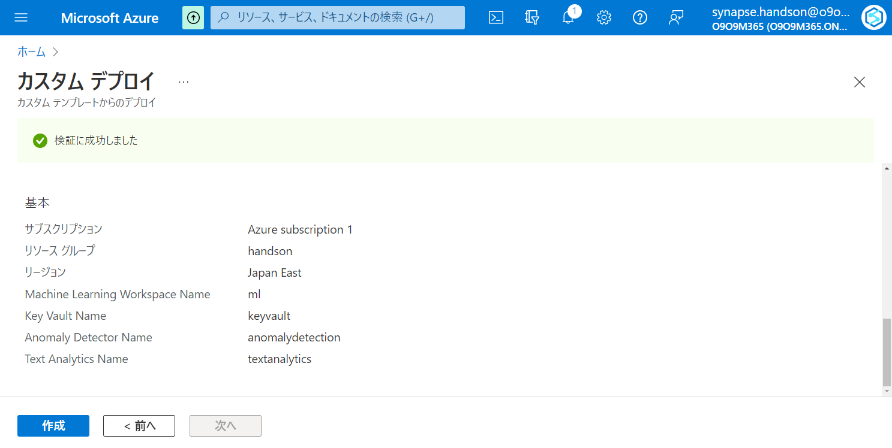

Slide 50
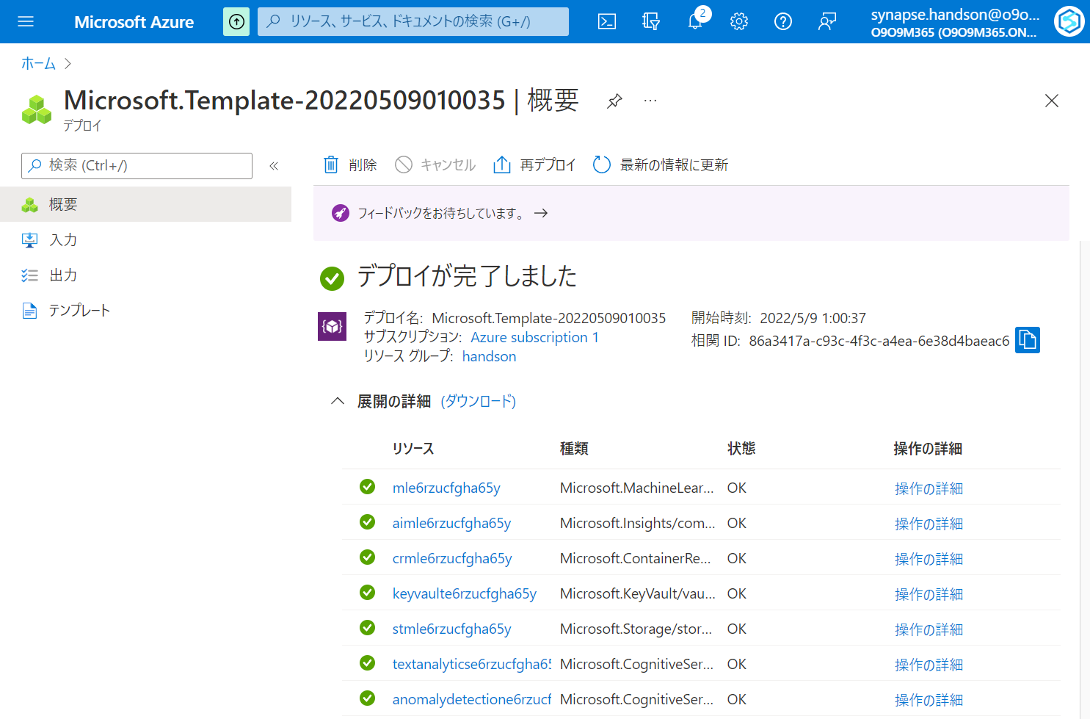

Slide 51
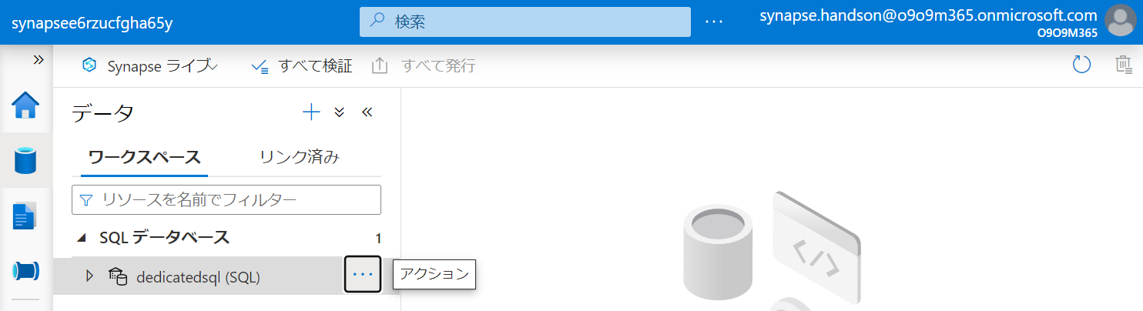

Slide 52
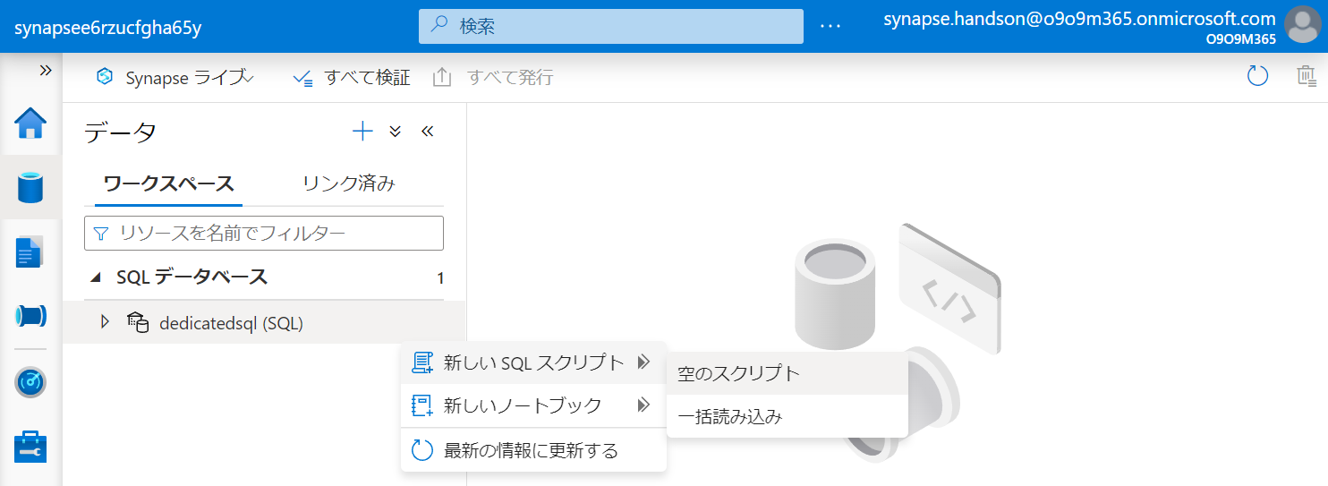

Slide 53
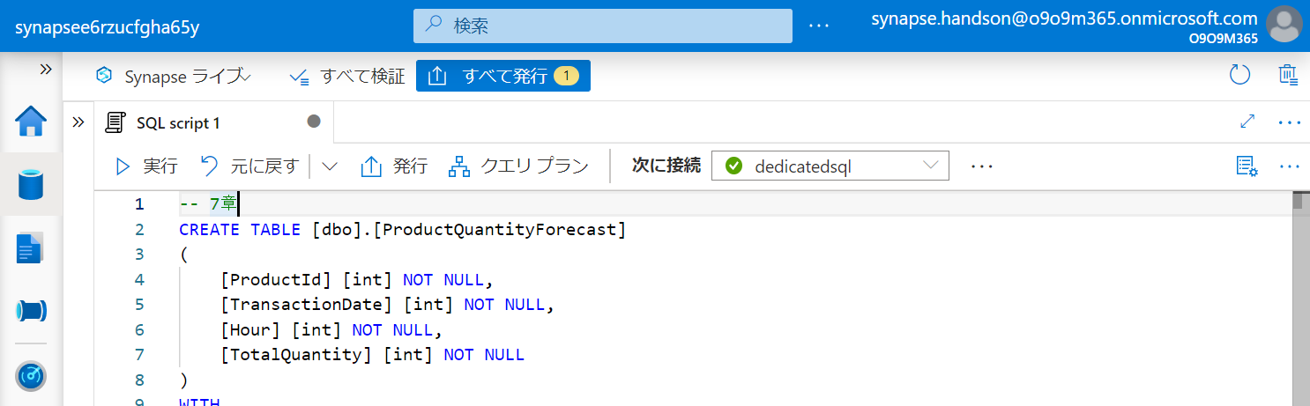

Slide 54


Slide 55


Slide 56


Slide 57


Slide 58


Slide 59


Slide 60


Slide 61


Slide 62


Slide 63


Slide 64


Slide 65


Slide 66


Slide 67


Slide 68


Slide 69


Slide 70


Slide 71


Slide 72


Slide 73
第5章：データの統合と可視化
Generate
Ingest
Store
Process
Enrich
Serve
Consume
On-Prems / Cloud
Realtime
Stream
Hot Path
IoT Hub
Batch
Functions
Power BI Premium
Dashboard
Event Hubs
Stream Analytics
Un/Semi -Structured
Cognitive Services
Analytics
SQL Database
Relational
Dedicated SQL
Data Explorer
Machine Learning
Cold Path
Dataflow
Cosmos DB
Data-driven Applications
Pipeline
NoSQL
Serverless Spark
Serverless SQL
HTAP with Synapse Link
Data Lake
Data Share
Shared Datasets
Discover & Govern
Azure Purview
Azure Active Directory
Azure Cost Management
Azure Key Vault
Azure Security Center
Platform
Azure Monitor
Azure DevOps
GitHub
Azure Policy

Slide 75


Slide 76


Slide 77


Slide 78


Slide 79


Slide 80


Slide 82


Slide 83


Slide 84


Slide 85


Slide 86


Slide 87


Slide 88


Slide 89


Slide 90


Slide 91


Slide 92


Slide 95


Slide 97


Slide 98


Slide 99


Slide 101


Slide 102


Slide 103


Slide 104


Slide 105


Slide 106


Slide 107


Slide 108


Slide 109


Slide 110


Slide 111


Slide 112

ドラッグ & ドロップ

Slide 113


Slide 114


Slide 115

ドラッグ & ドロップ

Slide 116


Slide 117


Slide 118


Slide 119


Slide 120


Slide 121


Slide 122


Slide 123


Slide 124


Slide 125


Slide 126


Slide 127


Slide 128


Slide 129


Slide 130


Slide 131


Slide 132


Slide 133


Slide 134


Slide 135


Slide 136


Slide 137


Slide 138


Slide 139


Slide 140


Slide 141


Slide 142


Slide 143


Slide 144


Slide 145


Slide 146


Slide 147


Slide 148


Slide 149


Slide 150


Slide 151


Slide 152


Slide 153


Slide 154

ドラッグ & ドロップ

Slide 155


Slide 156


Slide 157


Slide 158


Slide 159


Slide 160


Slide 161


Slide 162


Slide 163


Slide 164


Slide 165


Slide 166


Slide 167


Slide 168


Slide 169


Slide 170


Slide 171


Slide 172


Slide 173


Slide 174


Slide 175


Slide 176


Slide 177


Slide 178


Slide 179


Slide 180


Slide 181


Slide 182


Slide 183


Slide 184
第6章：アドホックデータ探索とデータプレパレーション
Generate
Ingest
Store
Process
Enrich
Serve
Consume
On-Prems / Cloud
Realtime
Stream
Hot Path
IoT Hub
Batch
Functions
Power BI Premium
Dashboard
Event Hubs
Stream Analytics
Un/Semi -Structured
Cognitive Services
Analytics
SQL Database
Relational
Dedicated SQL
Data Explorer
Machine Learning
Cold Path
Dataflow
Cosmos DB
Data-driven Applications
Pipeline
NoSQL
Serverless Spark
Serverless SQL
HTAP with Synapse Link
Data Lake
Data Share
Shared Datasets
Discover & Govern
Azure Purview
Azure Active Directory
Azure Cost Management
Azure Key Vault
Azure Security Center
Platform
Azure Monitor
Azure DevOps
GitHub
Azure Policy

Slide 185


Slide 186


Slide 187


Slide 188


Slide 189


Slide 190


Slide 191


Slide 192


Slide 193


Slide 194


Slide 195


Slide 196


Slide 197


Slide 198


Slide 199


Slide 200


Slide 201


Slide 202


Slide 203


Slide 204


Slide 205


Slide 206


Slide 207


Slide 208


Slide 209


Slide 210


Slide 211
第7章：機械学習統合によるデータエンリッチメント
Generate
Ingest
Store
Process
Enrich
Serve
Consume
On-Prems / Cloud
Realtime
Stream
Hot Path
IoT Hub
Batch
Functions
Power BI Premium
Dashboard
Event Hubs
Stream Analytics
Un/Semi -Structured
Cognitive Services
Analytics
SQL Database
Relational
Dedicated SQL
Data Explorer
Machine Learning
Cold Path
Dataflow
Cosmos DB
Data-driven Applications
Pipeline
NoSQL
Serverless Spark
Serverless SQL
HTAP with Synapse Link
Data Lake
Data Share
Shared Datasets
Discover & Govern
Azure Purview
Azure Active Directory
Azure Cost Management
Azure Key Vault
Azure Security Center
Platform
Azure Monitor
Azure DevOps
GitHub
Azure Policy

Slide 212


Slide 213


Slide 214


Slide 216


Slide 217


Slide 218


Slide 219


Slide 220


Slide 221


Slide 222


Slide 223


Slide 224


Slide 225


Slide 226


Slide 227


Slide 228


Slide 229


Slide 230


Slide 231


Slide 232


Slide 233


Slide 234


Slide 235


Slide 236


Slide 237


Slide 238


Slide 239


Slide 240


Slide 241


Slide 242


Slide 243


Slide 244


Slide 245


Slide 247


Slide 248


Slide 249


Slide 250


Slide 251


Slide 252


Slide 253


Slide 254


Slide 255


Slide 257


Slide 258


Slide 259


Slide 260

Synapse Pipeline / Dataflow

Slide 261


Slide 262


Slide 263


Slide 264


Slide 265


Slide 266


Slide 267


Slide 269


Slide 270


Slide 271


Slide 272


Slide 273


Slide 274


Slide 275


Slide 276


Slide 277
第8章：リアルタイムデータ分析
Generate
Ingest
Store
Process
Enrich
Serve
Consume
On-Prems / Cloud
Realtime
Stream
Hot Path
IoT Hub
Batch
Functions
Power BI Premium
Dashboard
Event Hubs
Stream Analytics
Un/Semi -Structured
Cognitive Services
Analytics
SQL Database
Relational
Dedicated SQL
Data Explorer
Machine Learning
Cold Path
Dataflow
Cosmos DB
Data-driven Applications
Pipeline
NoSQL
Serverless Spark
Serverless SQL
HTAP with Synapse Link
Data Lake
Data Share
Shared Datasets
Discover & Govern
Azure Purview
Azure Active Directory
Azure Cost Management
Azure Key Vault
Azure Security Center
Platform
Azure Monitor
Azure DevOps
GitHub
Azure Policy

Slide 278


Slide 279


Slide 281


Slide 282


Slide 283


Slide 286


Slide 287


Slide 288


Slide 290


Slide 291

ドラッグ & ドロップ

Slide 292


Slide 293


Slide 294


Slide 295


Slide 296


Slide 297


Slide 298


Slide 299


Slide 301


Slide 302


Slide 303


Slide 304


Slide 305


Slide 306


Slide 307


Slide 308


Slide 309


Slide 310


Slide 311


Slide 312


Slide 313


Slide 314


Slide 315


Slide 316


Slide 317


Slide 318


Slide 319


Slide 320


Slide 321


Slide 322


Slide 323


Slide 324


Slide 325


Slide 326


Slide 327


Slide 328


Slide 329


Slide 330


Slide 331


Slide 332


Slide 333


Slide 334


Slide 335


Slide 336


Slide 337


Slide 338


Slide 339


Slide 340


Slide 341


Slide 342


Slide 343


Slide 345


Slide 346


Slide 347


Slide 348


Slide 349


Slide 351


Slide 352


Slide 353


Slide 354


Slide 355


Slide 356


Slide 357


Slide 358


Slide 359


Slide 360


Slide 361


Slide 362


Slide 363


Slide 364


Slide 365


Slide 366


Slide 367


Slide 368


Slide 369


Slide 370


Slide 371


Slide 372


Slide 373


Slide 374


Slide 375


Slide 377


Slide 378


Slide 379
END

Slide 384


Slide 385


Slide 386


Slide 387


Slide 388


Slide 389


Slide 390


Slide 391


Slide 392


Slide 393


Slide 394


Slide 395

不要

Slide 396

不要

Slide 397

不要

Slide 398

不要

Slide 399


Slide 400


Slide 402


Slide 403



Slide 404


Slide 406


Slide 408


Slide 409


Slide 410


Slide 411


Slide 412


Slide 413


Slide 414


Slide 415


Slide 416


Slide 417


Slide 418


Slide 419


Slide 420


Slide 421


Slide 422


Slide 423


Slide 425


Slide 426


Slide 427


Slide 428


Slide 429


Slide 430


Slide 432


Slide 433


Slide 434


Slide 435


Slide 436


Slide 437

右クリック

Slide 438


Slide 440


Slide 441


Slide 442


Slide 444


Slide 445


Slide 446


Slide 447


Slide 448


Slide 449


Slide 450


Slide 451


Slide 452


Slide 453


Slide 454

ドラッグ&ドロップ

Slide 455

ドラッグ&ドロップ

Slide 456


Slide 457


Slide 458

5-2-2-1

Slide 459

5-2-2-1

Slide 460

5-2-2-2

Slide 461

5-2-2-2

Slide 462

5-2-2-2
右クリック

Slide 463

5-2-2-2

Slide 464

5-3-1-1

Slide 465

5-3-1-1

Slide 466

5-3-1-2

Slide 467

5-3-1-2

Slide 468

5-3-1-2

Slide 469

5-3-1-2

Slide 470

5-3-1-2

Slide 471

5-3-1-2

Slide 472

5-3-1-2

Slide 473

5-3-1-2

Slide 474

5-3-1-2

Slide 475

5-3-1-2

Slide 476

5-3-1-2

Slide 477

5-3-1-2
Column Name | Expression
PickUpDate | toDate(tpep_pickup_datetime,'yyyy-MM-dd')
PickUpLocationID | toInteger(PULocationID)
PassengerCount | toInteger(passenger_count)
DistanceTravelled | toDecimal(trip_distance)
TipAmount | toDecimal(tip_amount)
FareAmount | toDecimal(fare_amount)
TotalAmount | toDecimal(total_amount)

Slide 478

5-3-1-2

Slide 479

5-3-1-2

Slide 480

5-3-1-2
- Join Settings > Output stream name: JoinPickUpLocation - Join Settings > Left stream: TransformColumns - Join Settings > Right stream: TaxiLocationLookup - Join Settings > Join type: Inner - Join Settings > Join conditions > Left: PickUpLocationID - Join Settings > Join conditions > Right: LocationID

Slide 481

5-3-1-2

Slide 482

5-3-1-2
PickUpDate
PaymentType
Borough
Zone

Slide 483

5-3-1-2
Column Name | Expression
TotalTripCount | count()
TotalPassengerCount | sum(PassengerCount)
TotalDistanceTravelled | sum(DistanceTravelled)
TotalTipAmount | sum(TipAmount)
TotalFareAmount | sum(FareAmount)
TotalTripAmount | sum(TotalAmount)

Slide 484

5-3-1-2

Slide 485

5-3-1-2
Borough to PickUpBorough
Zone to PickUpZone

Slide 486

5-3-1-2

Slide 487

5-3-1-2

Slide 488

5-3-1-2

Slide 489

5-3-1-2

Slide 490

5-3-2-1
ドラッグ&ドロップ

Slide 491

5-3-2-2

Slide 492


5-3-2-3

Slide 493

5-3-2-4

Slide 494

5-3-2-4

Slide 495

5-3-2-5

Slide 496

5-3-2-6

Slide 497

5-3-2-6
右クリック

Slide 498

5-3-2-6

Slide 499


Slide 500


Slide 501


Slide 502


Slide 503


Slide 504


Slide 505


Slide 506


Slide 507


Slide 508



Power BI 環境
Synapse Studio からリンクする際にはワークスペースが必要
Power BI Service にログインしてもらいワークスペースを作成してもらう
ライセンスない場合は「無料で試す」から手続きしてもらう

Slide 509


Slide 510


Slide 511


Slide 512




Slide 513


Slide 514





Slide 515


Slide 516


ゲストアカウントをSynapse管理者として登録する方法
IAM追加
StudioからSynapse管理者として登録

Slide 518


Slide 519


Slide 520


Slide 521


Slide 522


Slide 523


Slide 524


Slide 525


Slide 526


Slide 527


Slide 528


Slide 529


Slide 530


Slide 531

コメントアウトを削除

Slide 532


Slide 533

コードをペースト

Slide 534


Slide 535


Slide 536


Slide 537


Slide 538


Slide 539


Slide 540


Slide 541


Slide 542


Slide 543


Slide 544


Slide 545


Slide 546


Slide 547


Slide 548



Slide 549


Slide 550


Slide 551


Slide 552


Slide 553


Slide 554


Slide 555


Slide 556



Slide 557



Slide 558



Slide 559


Slide 560


Slide 561


Slide 562


Slide 563


Slide 564


Slide 565



Slide 566



Slide 567


Slide 568


Slide 569


Slide 570


Slide 572


Slide 575


Slide 576


Slide 577


Slide 578


Slide 579


Slide 580


Slide 581


Slide 582


Slide 583


Slide 584


Slide 585


Slide 586


Slide 587


Slide 588
第8章：リアルタイムデータ分析
Generate
Ingest
Store
Process
Enrich
Serve
Consume
On-Prems / Cloud
Realtime
Stream
Hot Path
IoT Hub
Batch
Functions
Power BI Premium
Dashboard
Event Hubs
Stream Analytics
Un/Semi -Structured
Cognitive Services
Analytics
SQL Database
Relational
Dedicated SQL
Data Explorer
Machine Learning
Cold Path
Dataflow
Cosmos DB
Data-driven Applications
Pipeline
NoSQL
Serverless Spark
Serverless SQL
HTAP with Synapse Link
Data Lake
Data Share
Shared Datasets
Discover & Govern
Azure Purview
Azure Active Directory
Azure Cost Management
Azure Key Vault
Azure Security Center
Platform
Azure Monitor
Azure DevOps
GitHub
Azure Policy

Slide 589


Slide 590


Slide 591


Slide 592


Slide 593


Slide 594


Slide 595


Slide 596


Slide 597


Slide 598


Slide 599


Slide 600


Slide 601


Slide 602


Slide 603


Slide 604


Slide 605



Slide 606


Slide 607


Slide 608


Slide 609


Slide 610


Slide 611


Slide 612


Slide 613


Slide 614


Slide 615


Slide 616


Slide 617


Slide 618


Slide 619


Slide 620


Slide 621


Slide 622


Slide 623


Slide 624


Slide 625


Slide 626


Slide 627


Slide 628


Slide 629


Slide 630


Slide 631


Slide 632


Slide 633


Slide 634


Slide 635


Slide 636


Slide 637


Slide 638


Slide 639


Slide 640


Slide 641


Slide 642


Slide 643


Slide 644


Slide 645


Slide 646


Slide 647


Slide 648


Slide 649


Slide 650


Slide 651


Slide 652


Slide 653


Slide 654


Slide 655


Slide 656


Slide 657


Slide 658


Slide 659


Slide 660


Slide 661


Slide 662


Slide 663


Slide 664


Slide 665


Slide 666


Slide 667


Slide 668


Slide 669


Slide 670


Slide 671


Slide 672


Slide 673


Slide 674


Slide 675


Slide 676


Slide 677


Slide 678



Slide 679


Slide 680


Slide 681


Slide 682


Slide 683


Slide 684


Slide 685


Slide 686


Slide 687


Slide 688


Slide 689
レポートファイルを保存
この時の名前が PBIレポートとデータセットの名前になる

Slide 690


Slide 691


Slide 692


Slide 693


Slide 694


Slide 695


Slide 696

Azure SQL Database with DirectQuery - Power BI | Microsoft Docs

Slide 697


Slide 698


Slide 699


Slide 700


Slide 701


Slide 702


Slide 703


Slide 704


